Slide 1

Finding Outbreaks Faster
Mark S. Smolinski, MD, MPH
Director, Global Health,
Skoll Global Threats Fund
Digital Disease Detection Symposium
Phnom Penh
November 19, 2013

Slide 2


Why diseases spread quickly
A highly connected world of rapid transportation
Notes:
----- Meeting Notes (1/29/13 18:04) -----
And now we have the perfect marketing and distribution tools: circumnavigating jets! IN 1917/8, without any jets H1N1 circumnavigated the globe 4 times in one year. Today we can do it in 24 hours. Hundreds of times a year.

Slide 3
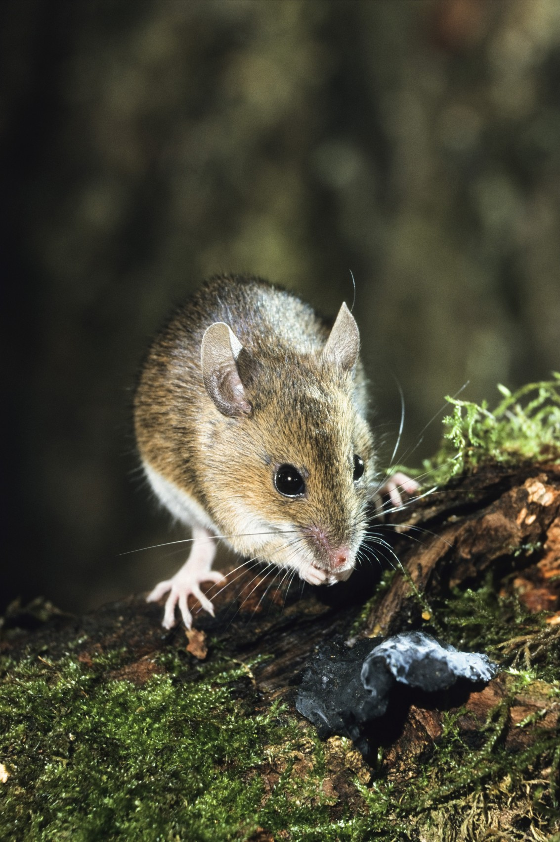
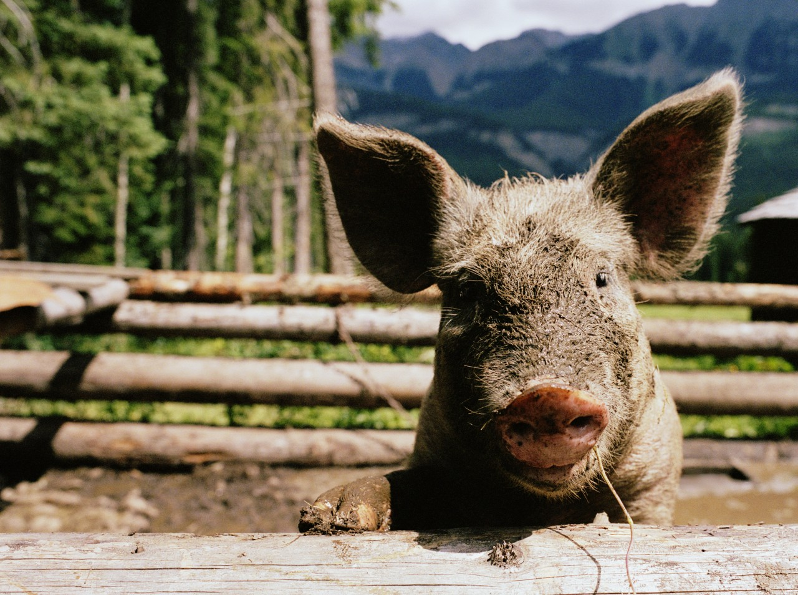
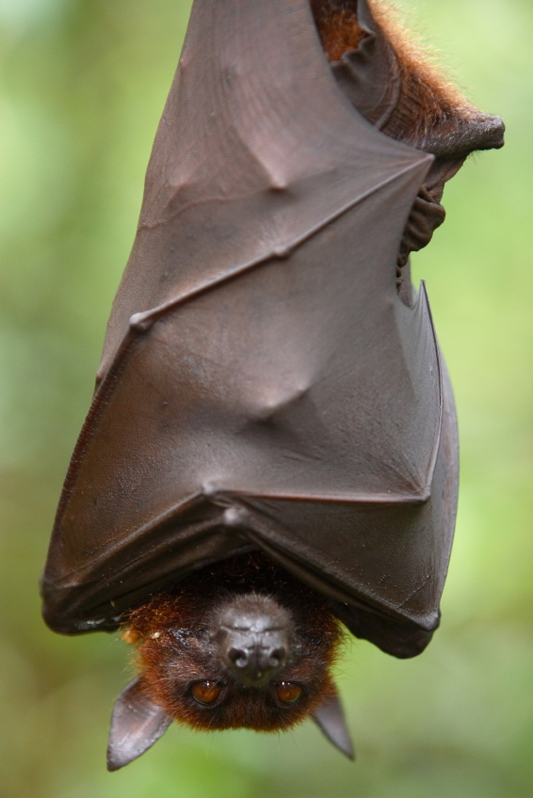
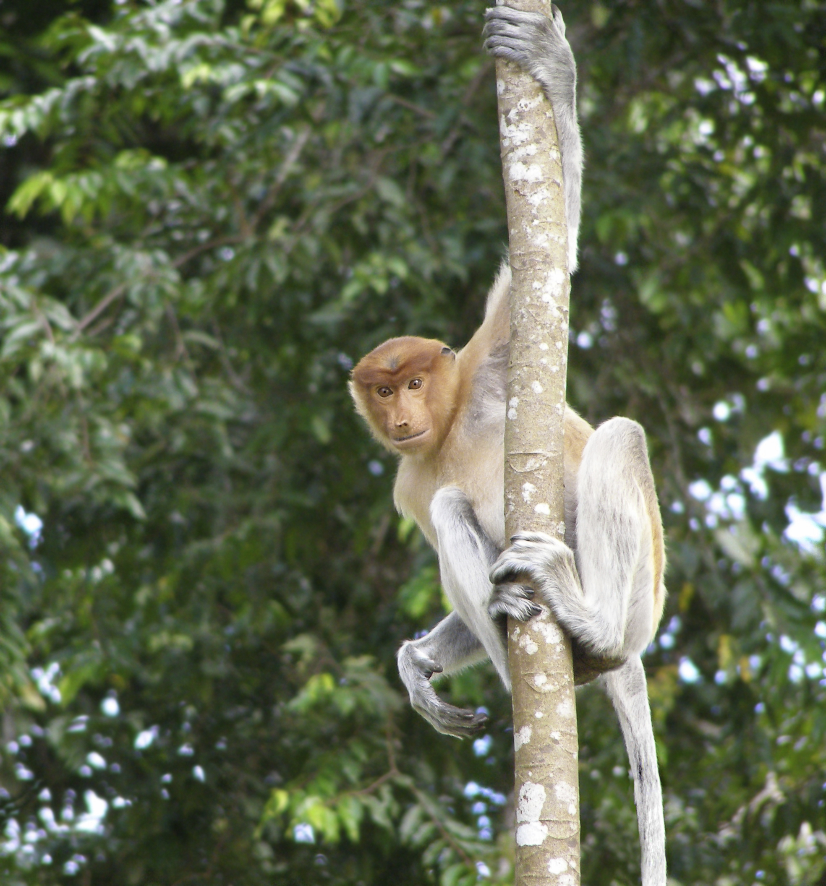
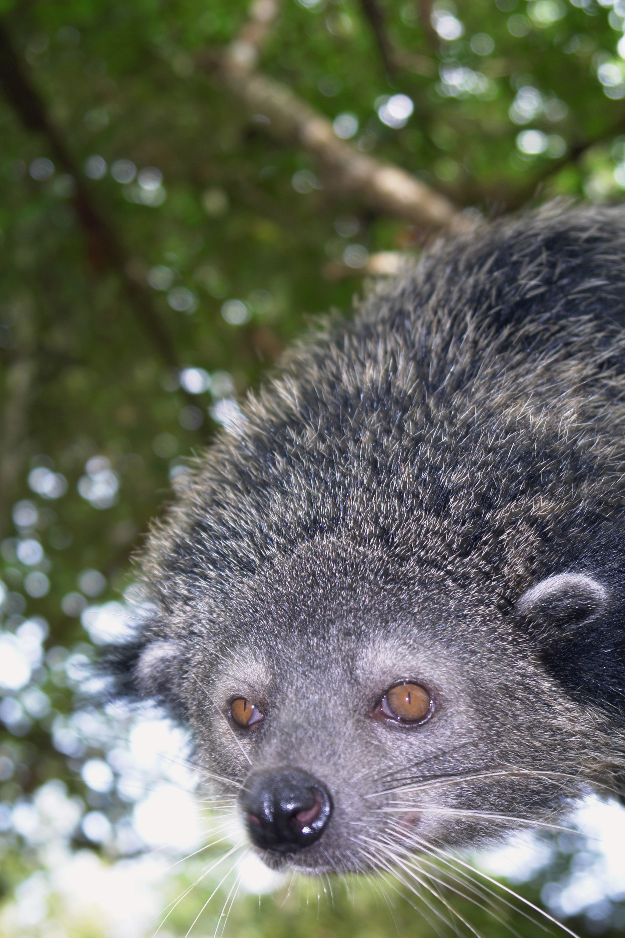
Why new diseases emerge
Increased number of new animal viruses jumping to humans
Notes:
Despite out best efforts, diseases jump from monkeys, pigs, birds and bats to humans. About three dozen such zoonotic diseases have newly infected humans in the past three decades: SARS, HIV/AIDS, ebola, lassa fever, West Nile, highly pathogenic avian influenza H5N1 (bird flu) and the 2009 pandemic H1N1 ‘swine’ flu to name a handful .
In addition, insects still carry malaria, dengue, and leptospirosis. Rodents harbor the next hantavirus or plague. We live amidst pandemic potential. We can’t stop this – it’s nature at work.

Slide 4
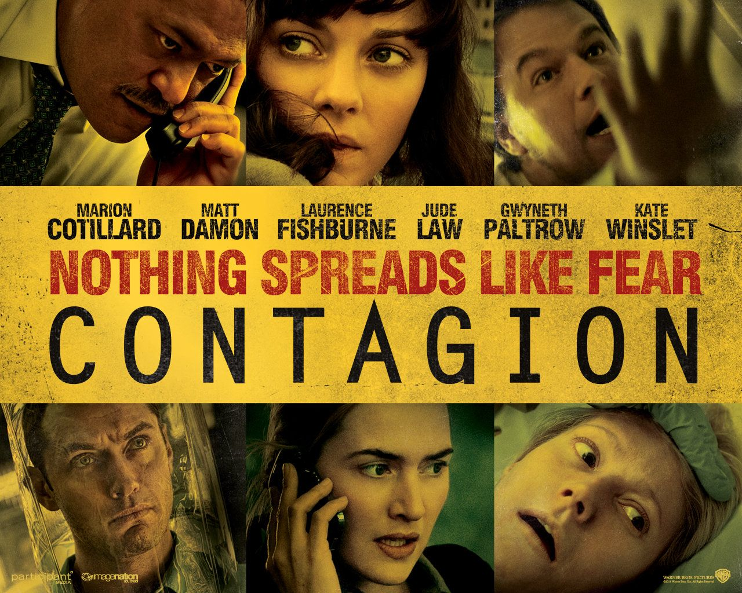
Notes:
Skoll Global Threats Fund has a sister organization, Participate Media. We have made several dozen award winning films: Lincoln, The Help, Goodbye and Goodluck, the Visitor, Inconvenient Truth, Waiting for Superman.
After H1N1 came and went and still people did not appreciate what a real pandemic woudl be like, Mark Smolinski and I gathered some of the top scientists and epidemiologist and helped make the movie Contagion which we wanted to show what a real pandemic wojuld like like.
This film staring an all star case was produced by Warner Bros and Participant, director Steven Soderbergh andfor us, most importanly written by Scott Z Burns who spend months with us getting the science right

Slide 5



Epidemic curve
CASES
Routine disease reporting
TIME

Slide 6

Epidemic curve
CASES
Routine disease reporting
Astute clinician reports
TIME

Slide 7
Epidemic curve
CASES
Routine disease reporting
Astute clinician reports
Sentinel networks
TIME

Slide 8
Epidemic curve
CASES
Routine disease reporting
Astute clinician reports
Sentinel networks
Digital disease detection
TIME

Slide 9
Epidemic curve
CASES
Routine disease reporting
Astute clinician reports
Sentinel networks
Digital disease detection
Participatory epidemiology
and future innovations
TIME

Slide 10
Epidemic curve
CASES
Routine disease reporting
Astute clinician reports
Sentinel networks
Digital disease detection
Participatory epidemiology
and future innovations
Even earlier: disease surveillance in animals
TIME

Slide 11
Early detection is working
23 Days
167 Days
50 DAYS
100 DAYS
150 DAYS
Chan et al. 2010. Proceedings of the National Academy of Sciences.

Slide 12
How big a difference is 23 days vs.167 days?
# SICK
Measles
Ro=12.5
Incubation period 7-10 days
`
23 days
167 days
TIME
Notes:
If we take a specific case such as measles. We know that measles has a reproductive rate of 12.5 So, assuming we have a fixed rate of susceptible individuals within a population, if the
Outbreak were detected as in 1996 with an average of 167 days, and we assume the epidemic is detected at the midpoint, this red epicurve would represent the number of infected individuals with measles.
If we use the same assumptions, that the outbreak is detected at the midpoint, BUT the time to detection is 23 days as it is closer to today, then the yellow curve represents the significant proportional decrease in the number of person infected.

Slide 13

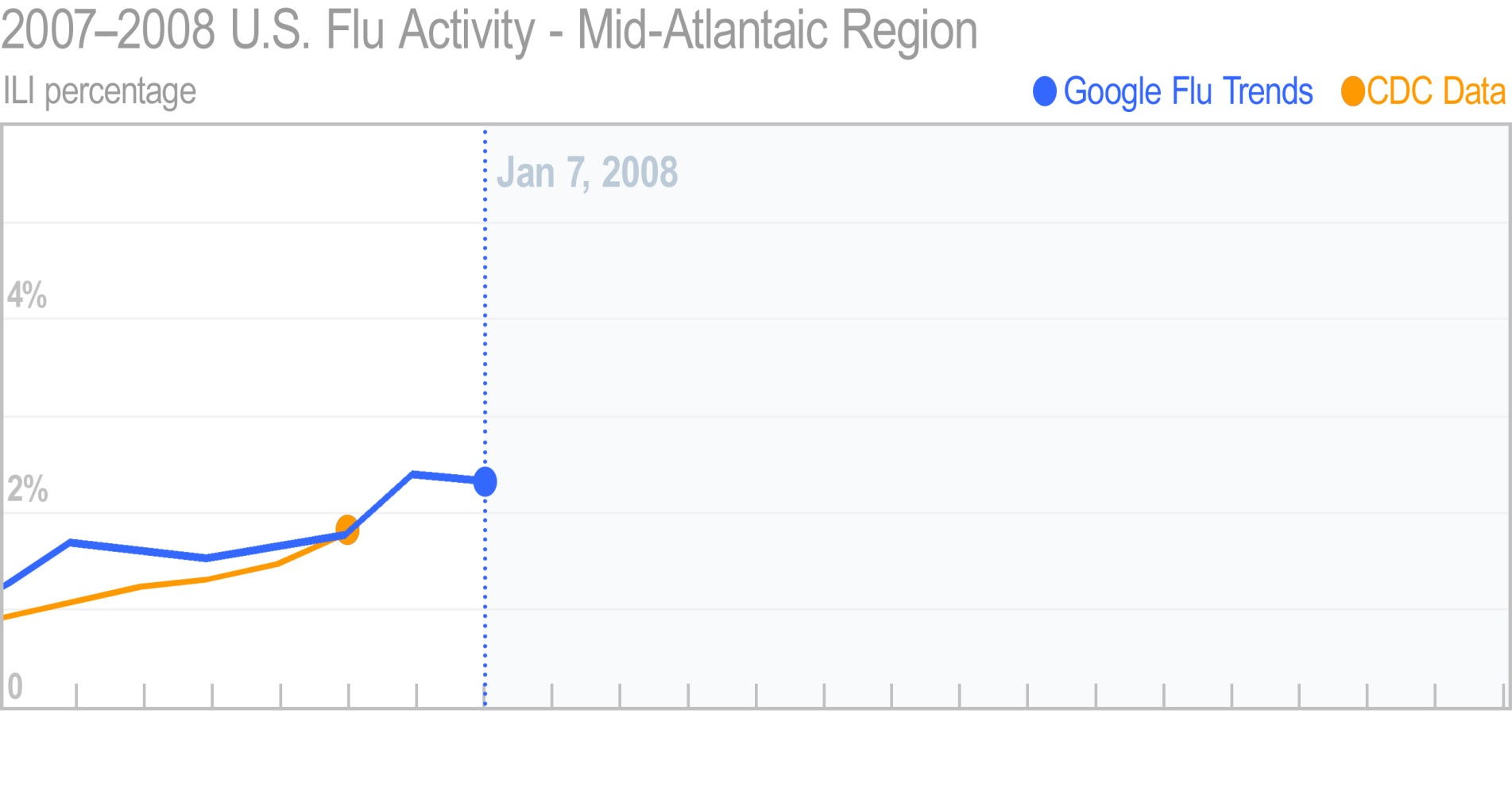

Flu Trends

Slide 14
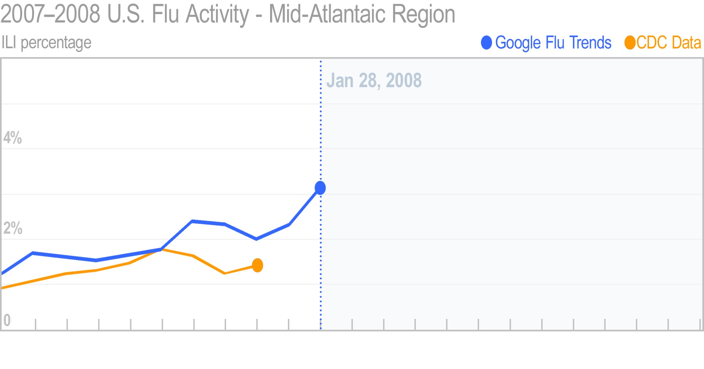
Flu Trends

Slide 15
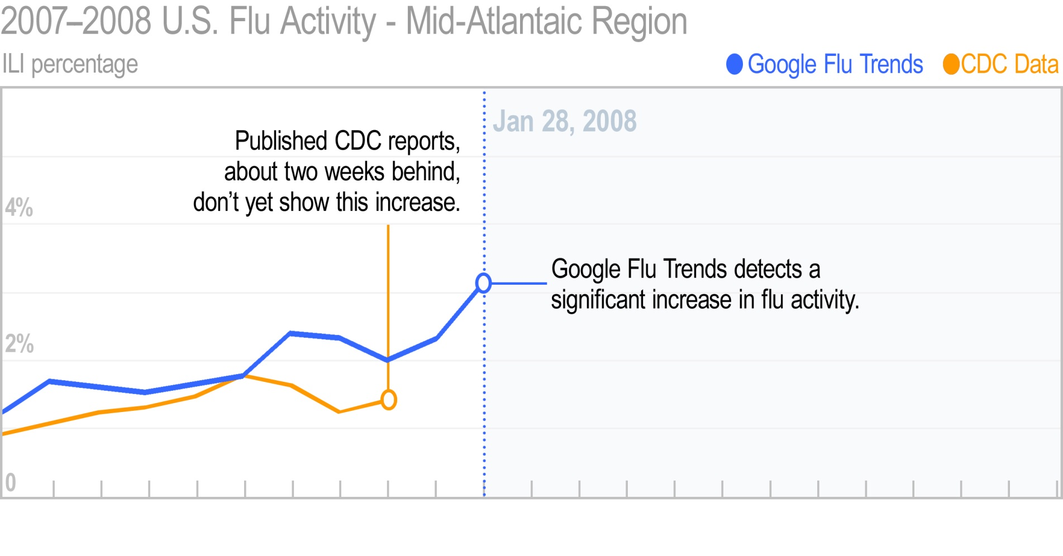
Flu Trends

Slide 16
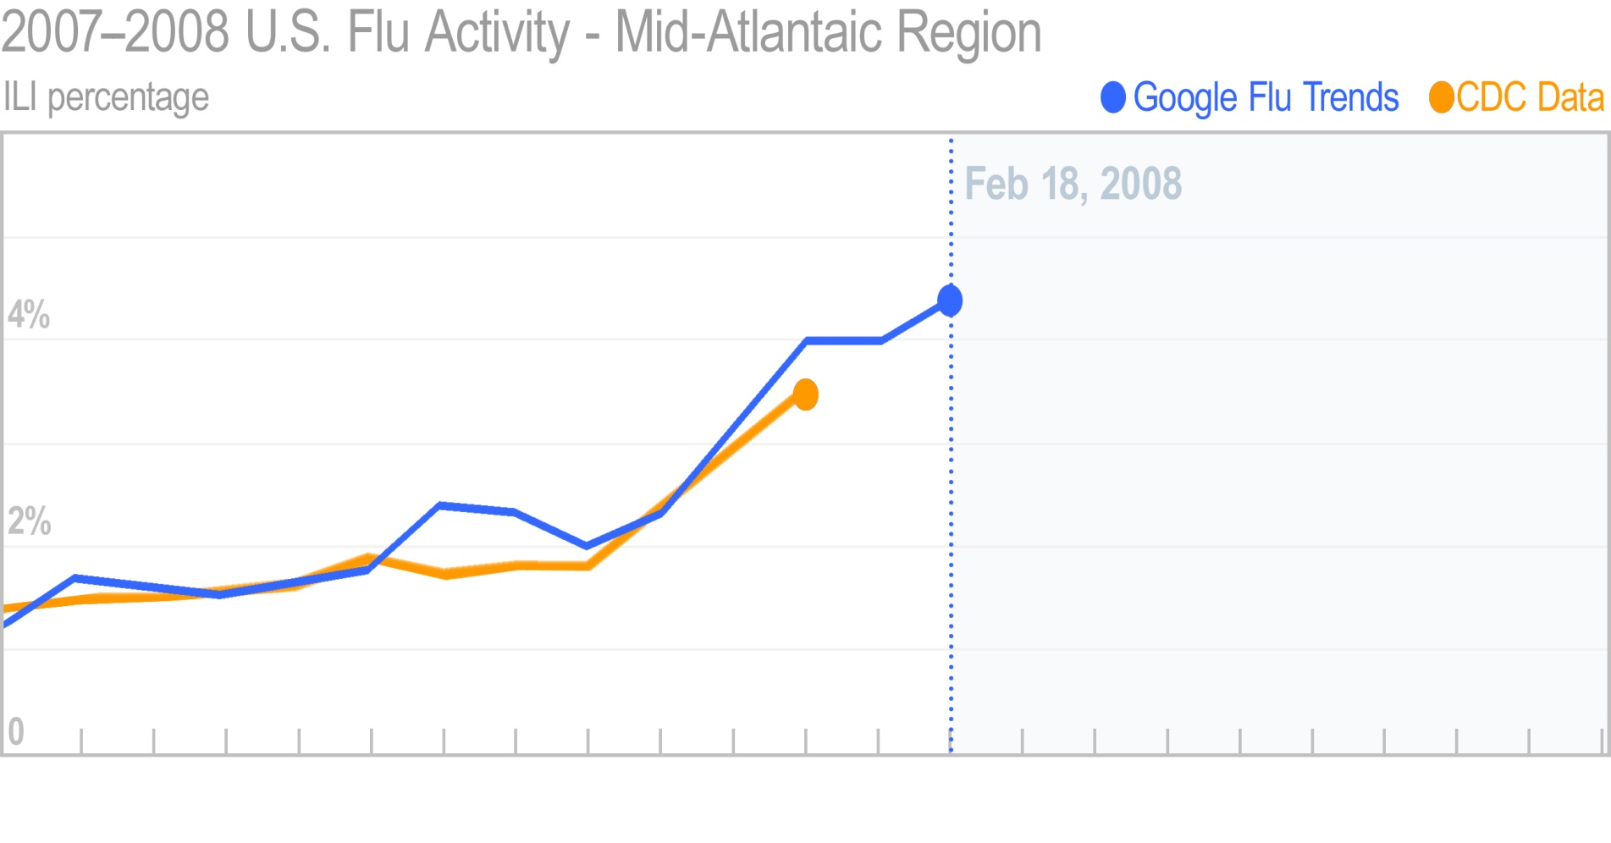
Flu Trends

Slide 17
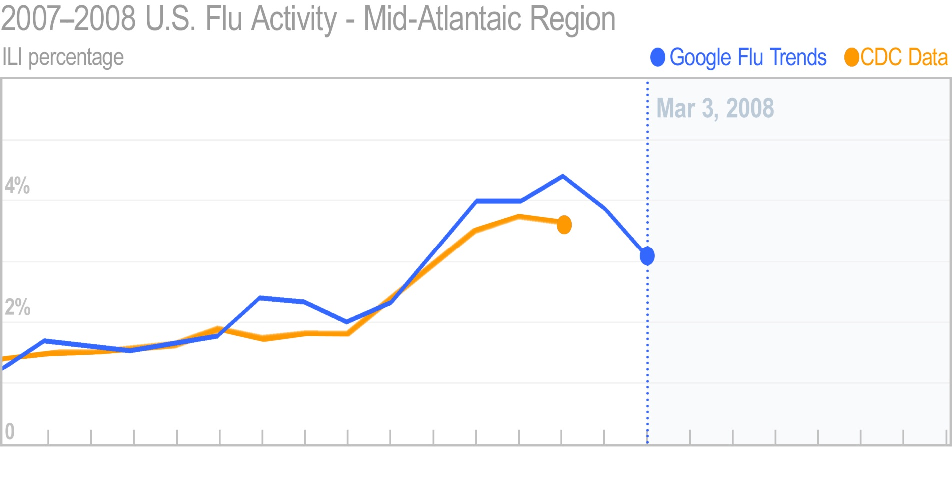
Flu Trends

Slide 18
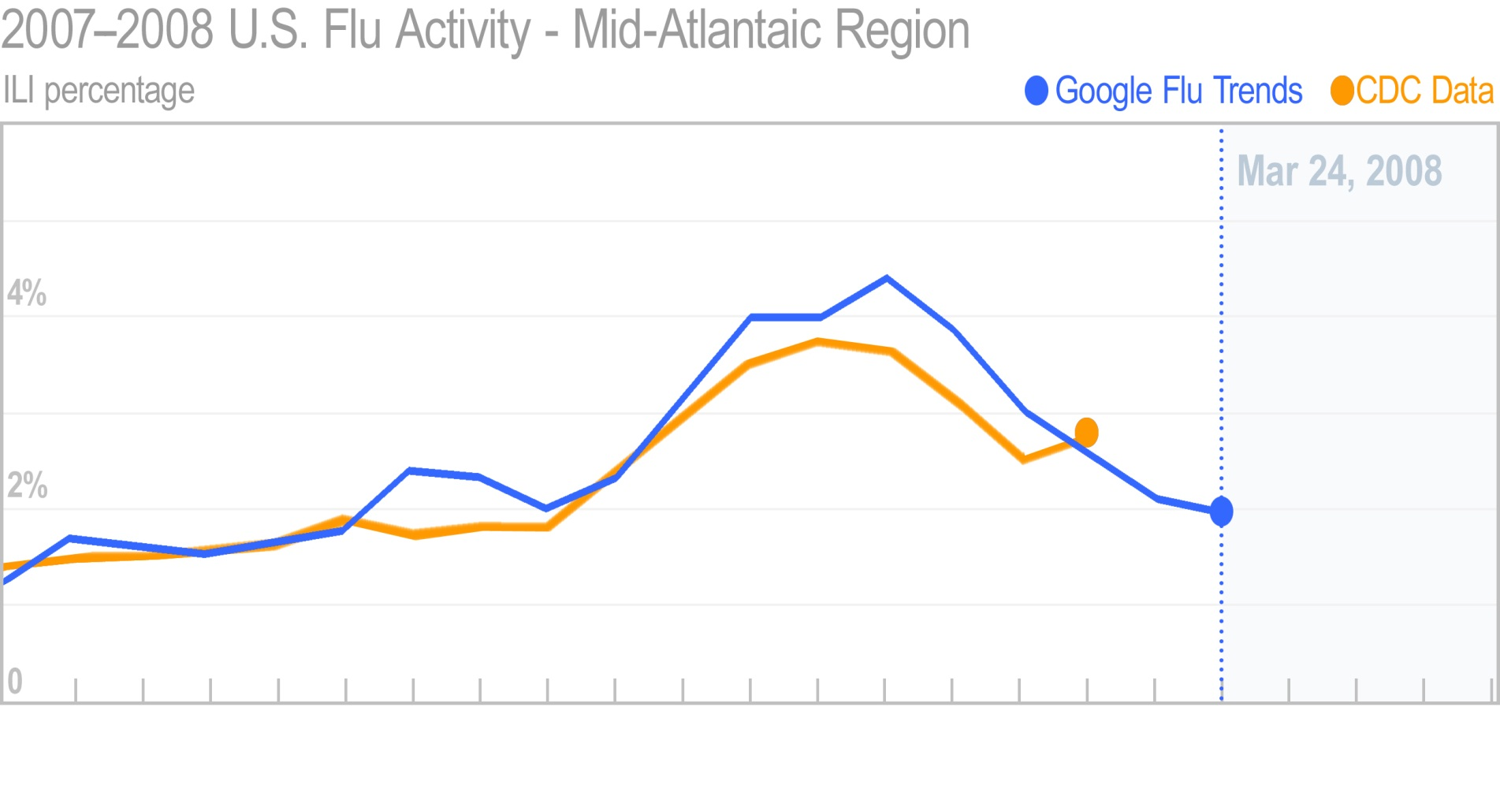
Flu Trends

Slide 19
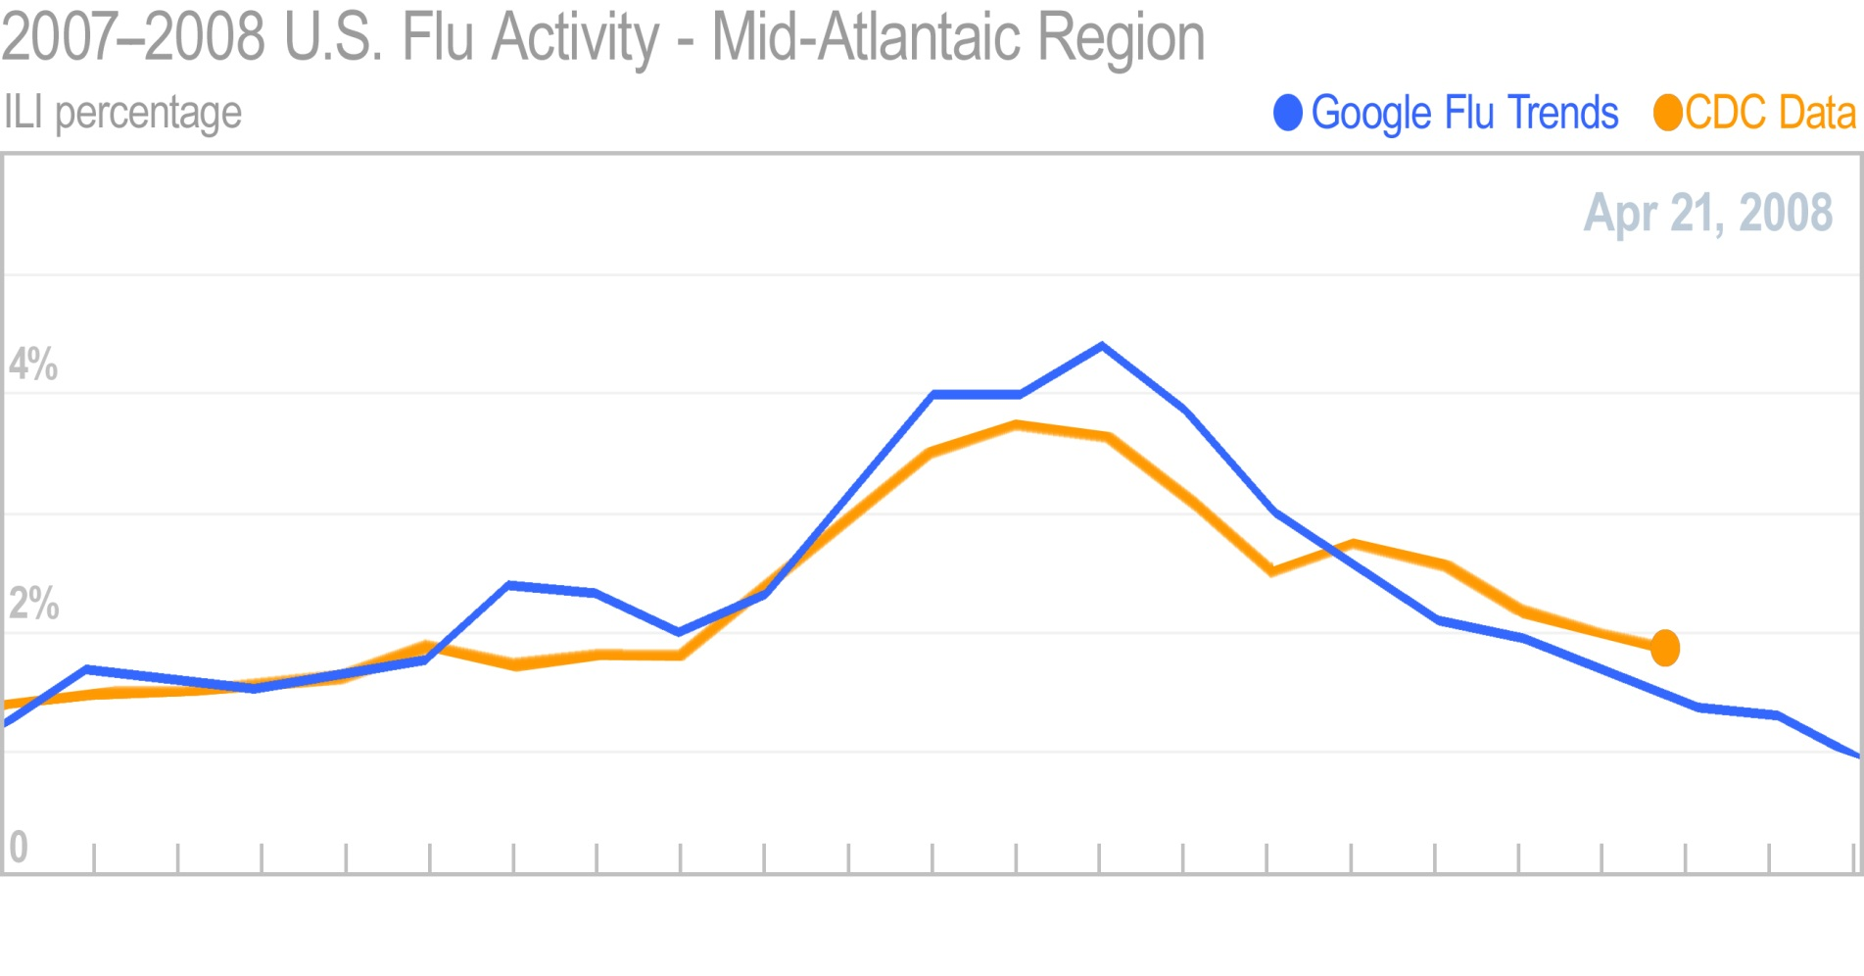
Flu Trends

Slide 20

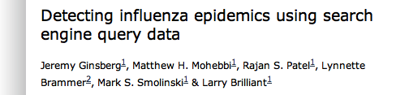
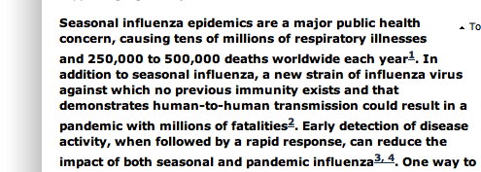
Notes:
Three young engineers at Google saw my TED talk and decided to use their 20% time to look into data captured by Google, into key strokes and search querieis and ask if Google had within its “cloud” the keys to early ddetection of inluenza.
Using CDC’s 5 year reports of flu in the US and every keystroke entered into Google and millions of computers---they used to find out the periods of down time and use virutally all of Googles computring capacity
they beat CDCs reports by two weeks. remember what I said about how valuable it is to detect epidemics two weeks earlier.
The data we’ve received was so compelling, we were able to publish an article in Nature Magazine about it, helping move digital disease surveillance more formally into the public health arena.

Slide 21




Early detection is working
New ideas, policies
and technologies
Quicker
Detection
=
Smaller
Epidemics
50 DAYS
100 DAYS
150 DAYS
Chan et al. 2010. Proceedings of the National Academy of Sciences.

Slide 22
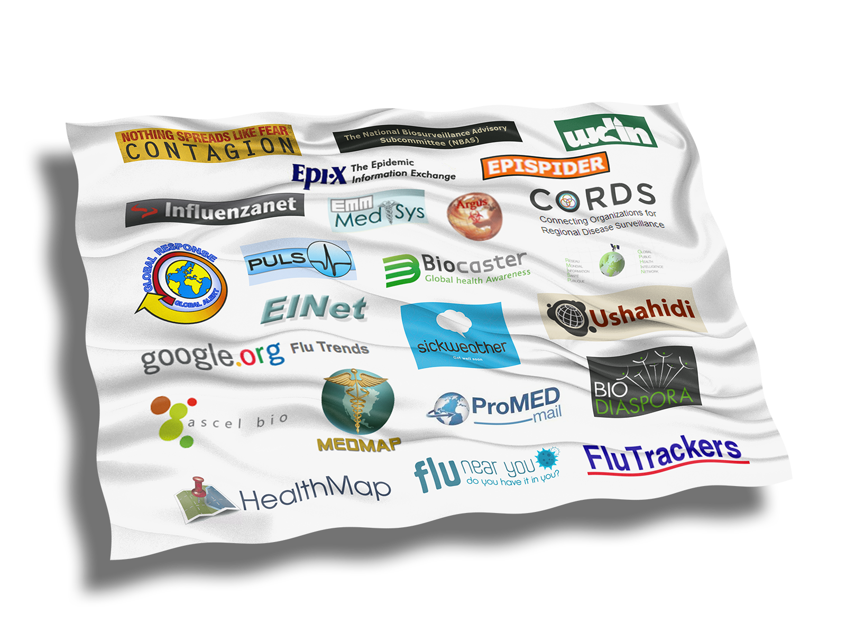
New ideas, policies and technology
New ideas, policies
and technologies
Quicker
Detection
=
Smaller
Epidemics
50 DAYS
100 DAYS
150 DAYS
Chan et al. 2010. Proceedings of the National Academy of Sciences.

Slide 23
A Better and Faster Signal?

Slide 24
A Better and Faster Signal?

Slide 25
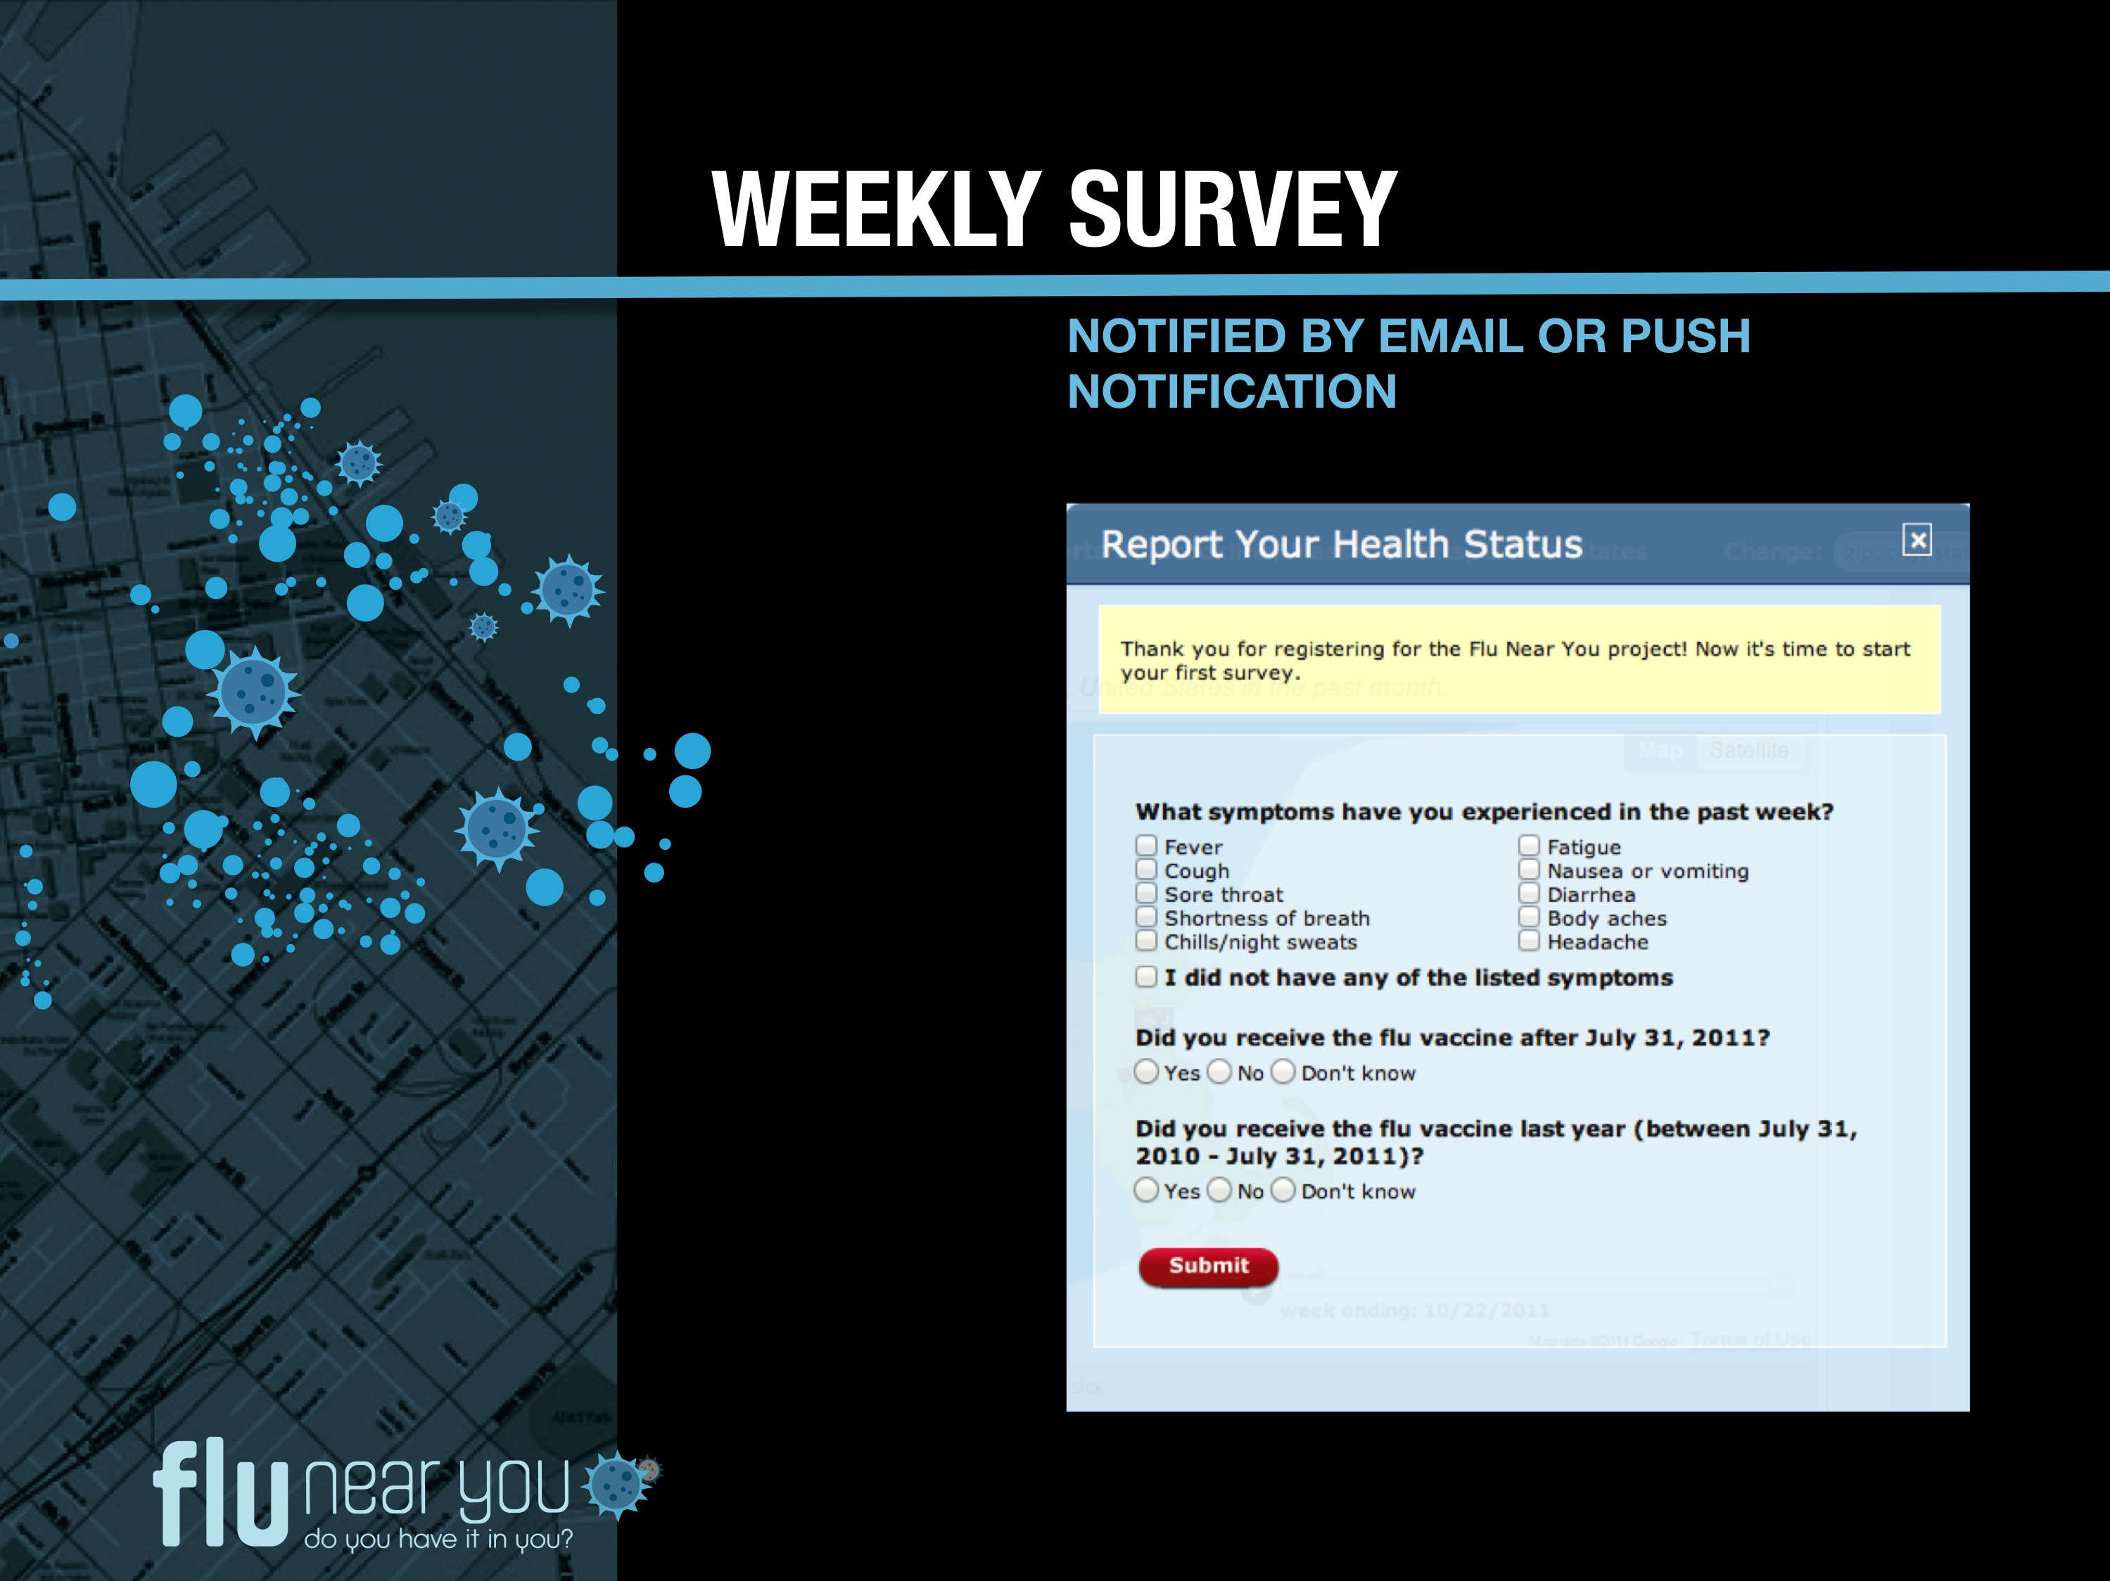
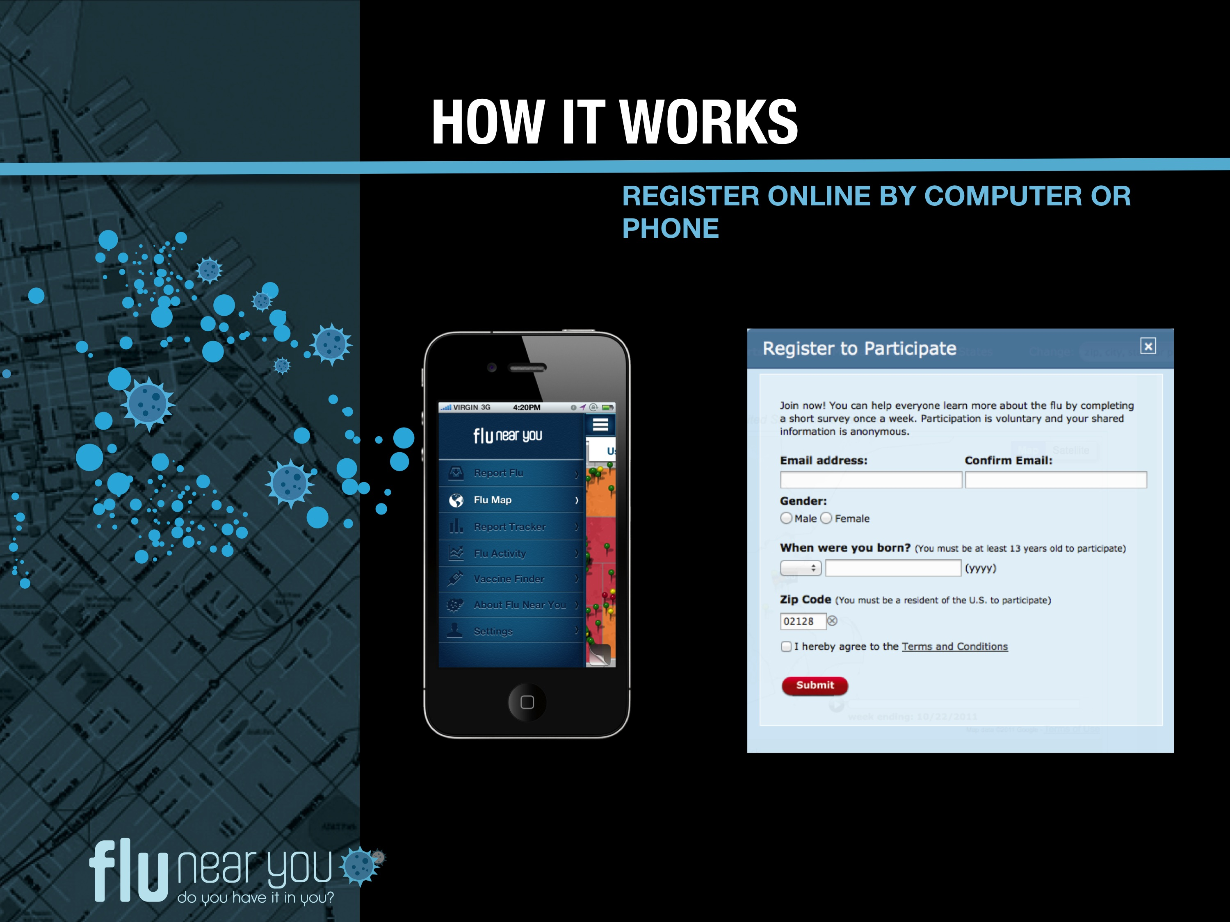

Slide 26
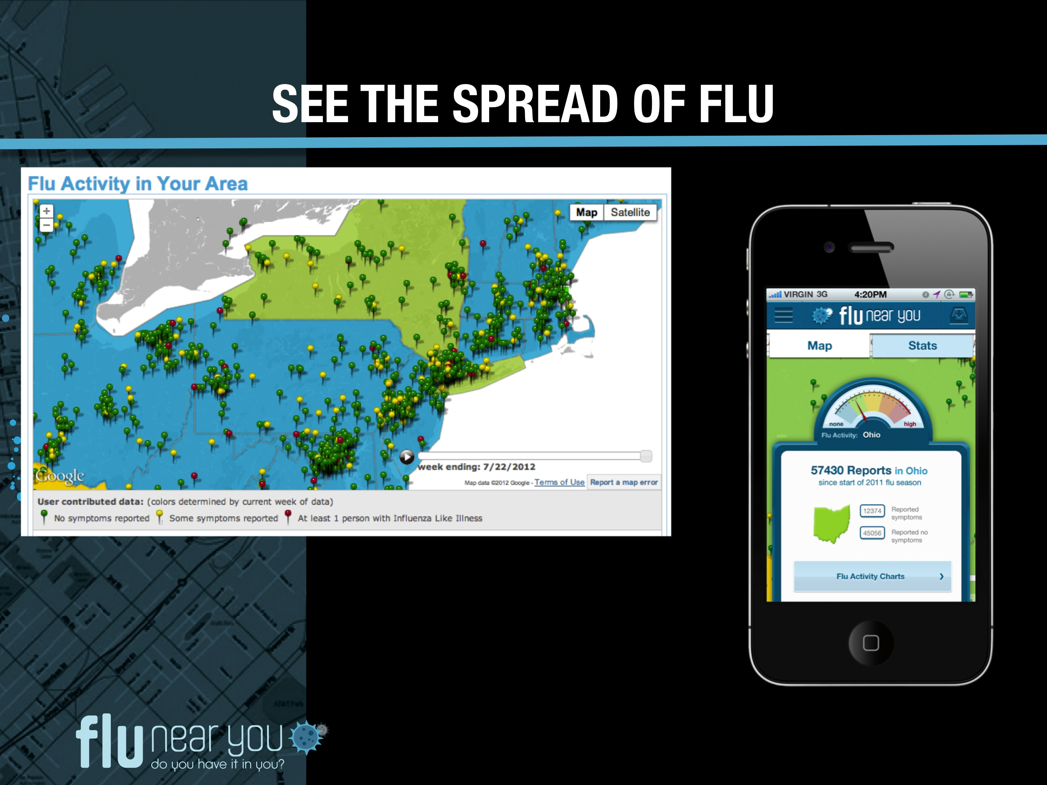

Slide 27
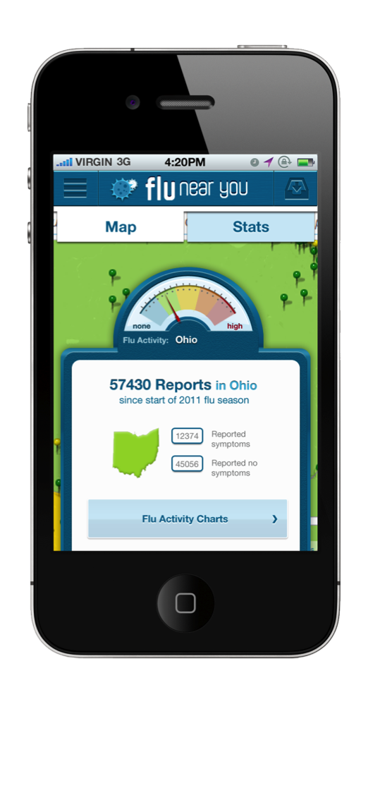
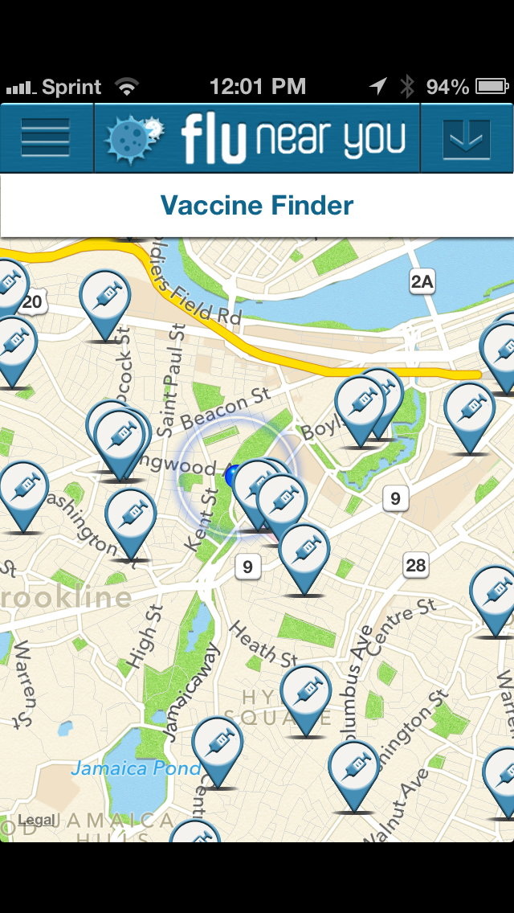
Vaccine information
Notes:
HealthMap’s Vaccine Finder has been integrated into the tool to provide users with an opportunity for action. Vaccine Finder helps you determine what vaccine is best for you and where to access it.

Slide 28
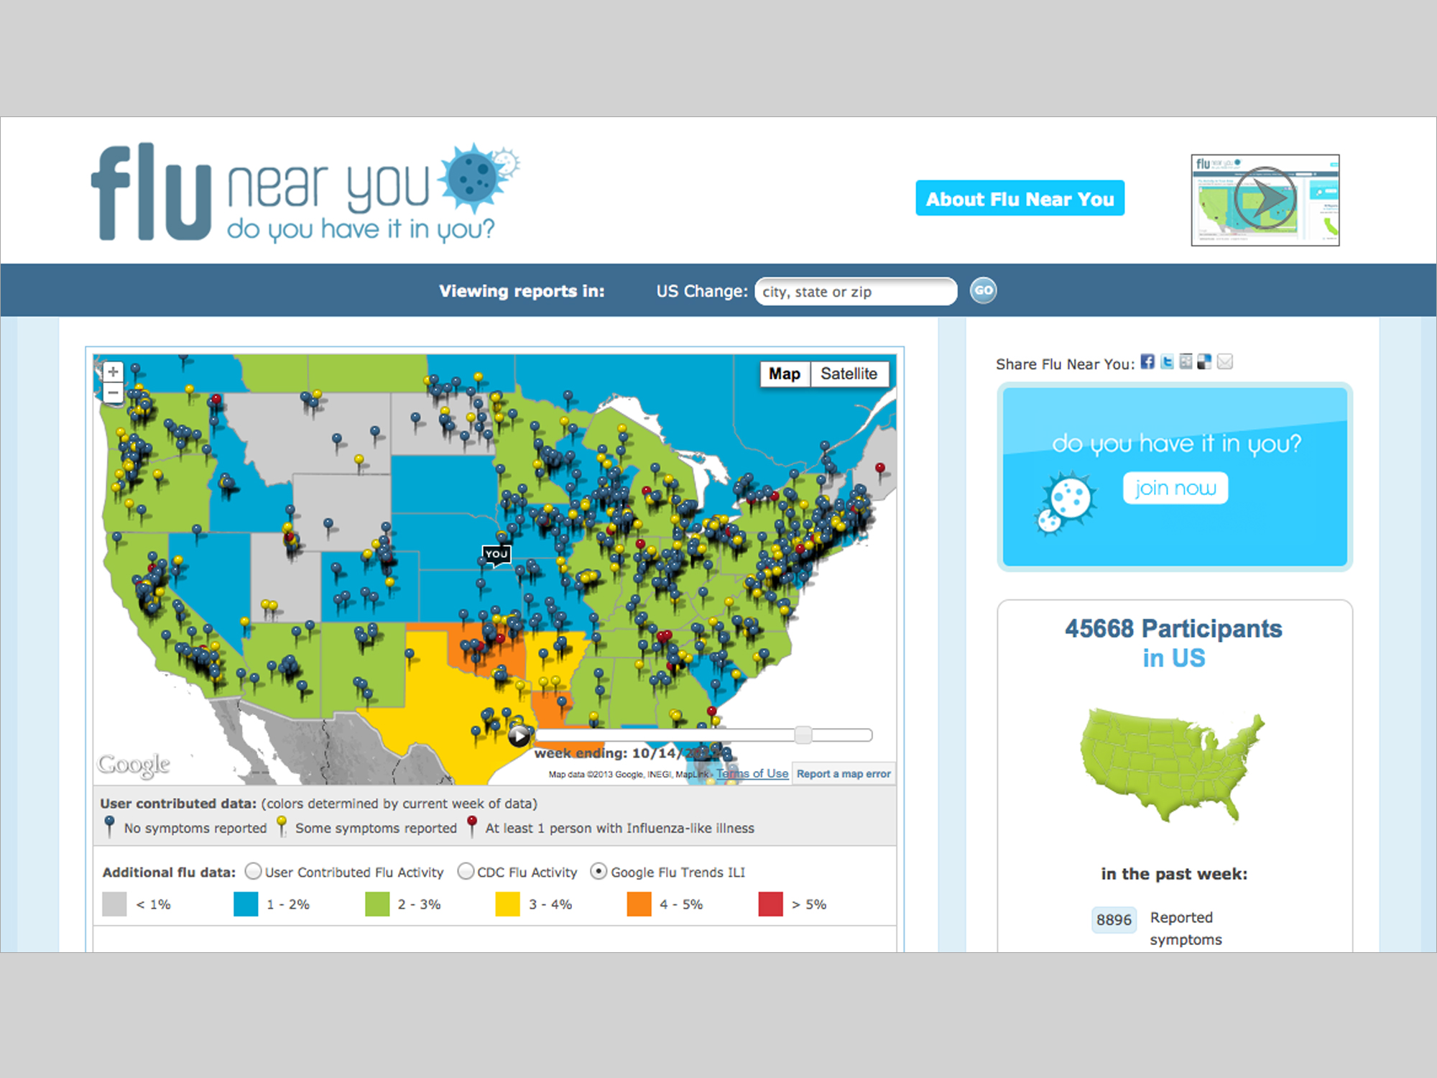


Slide 29
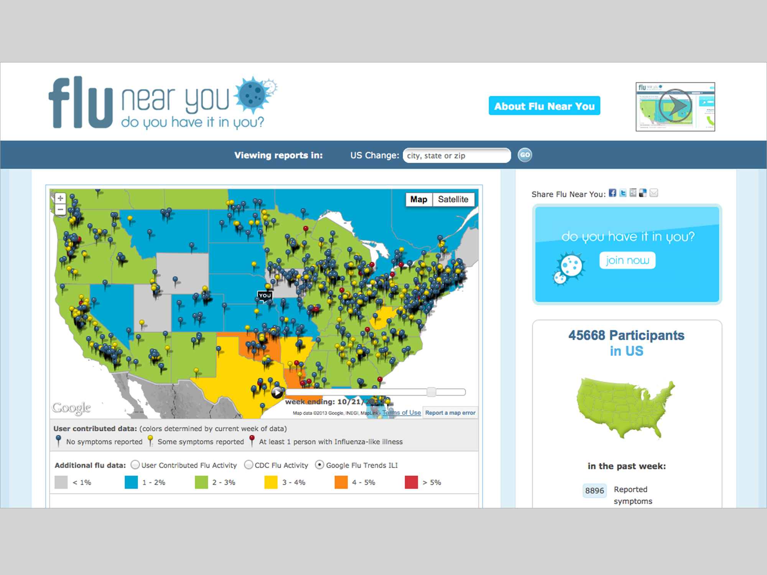

Slide 30
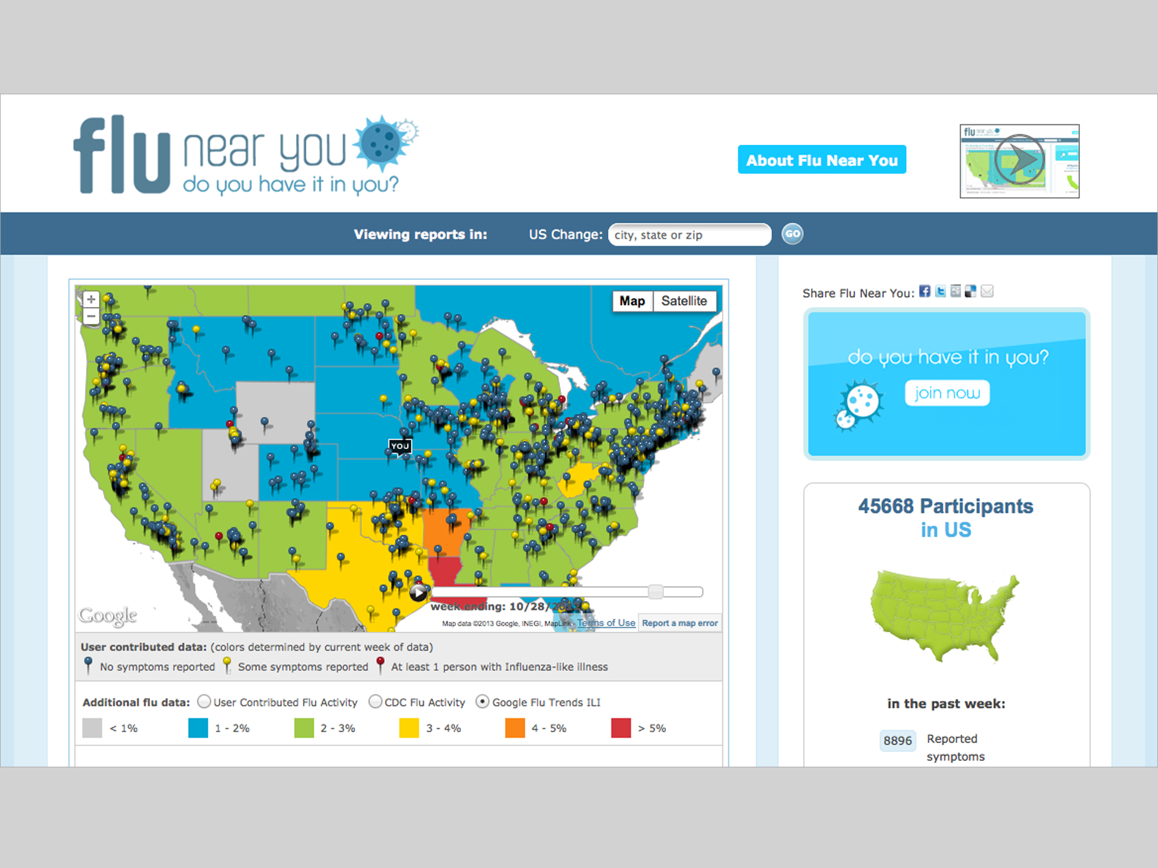

Slide 31
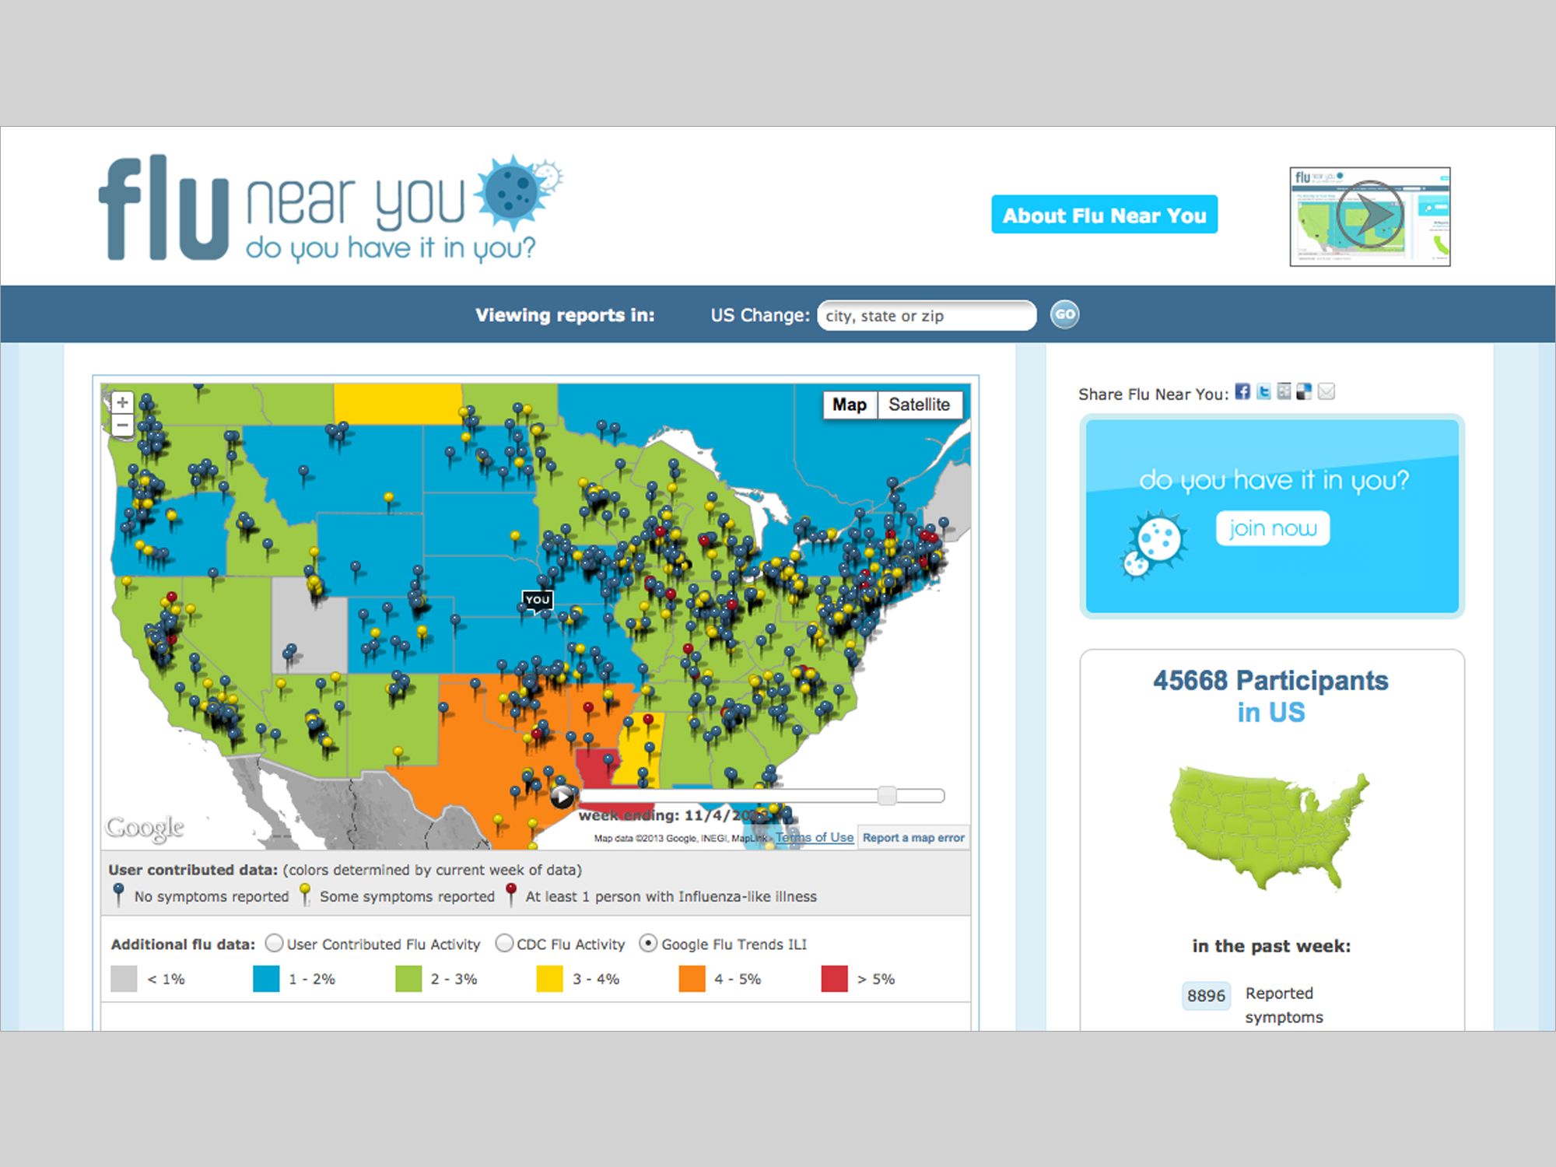

Slide 32
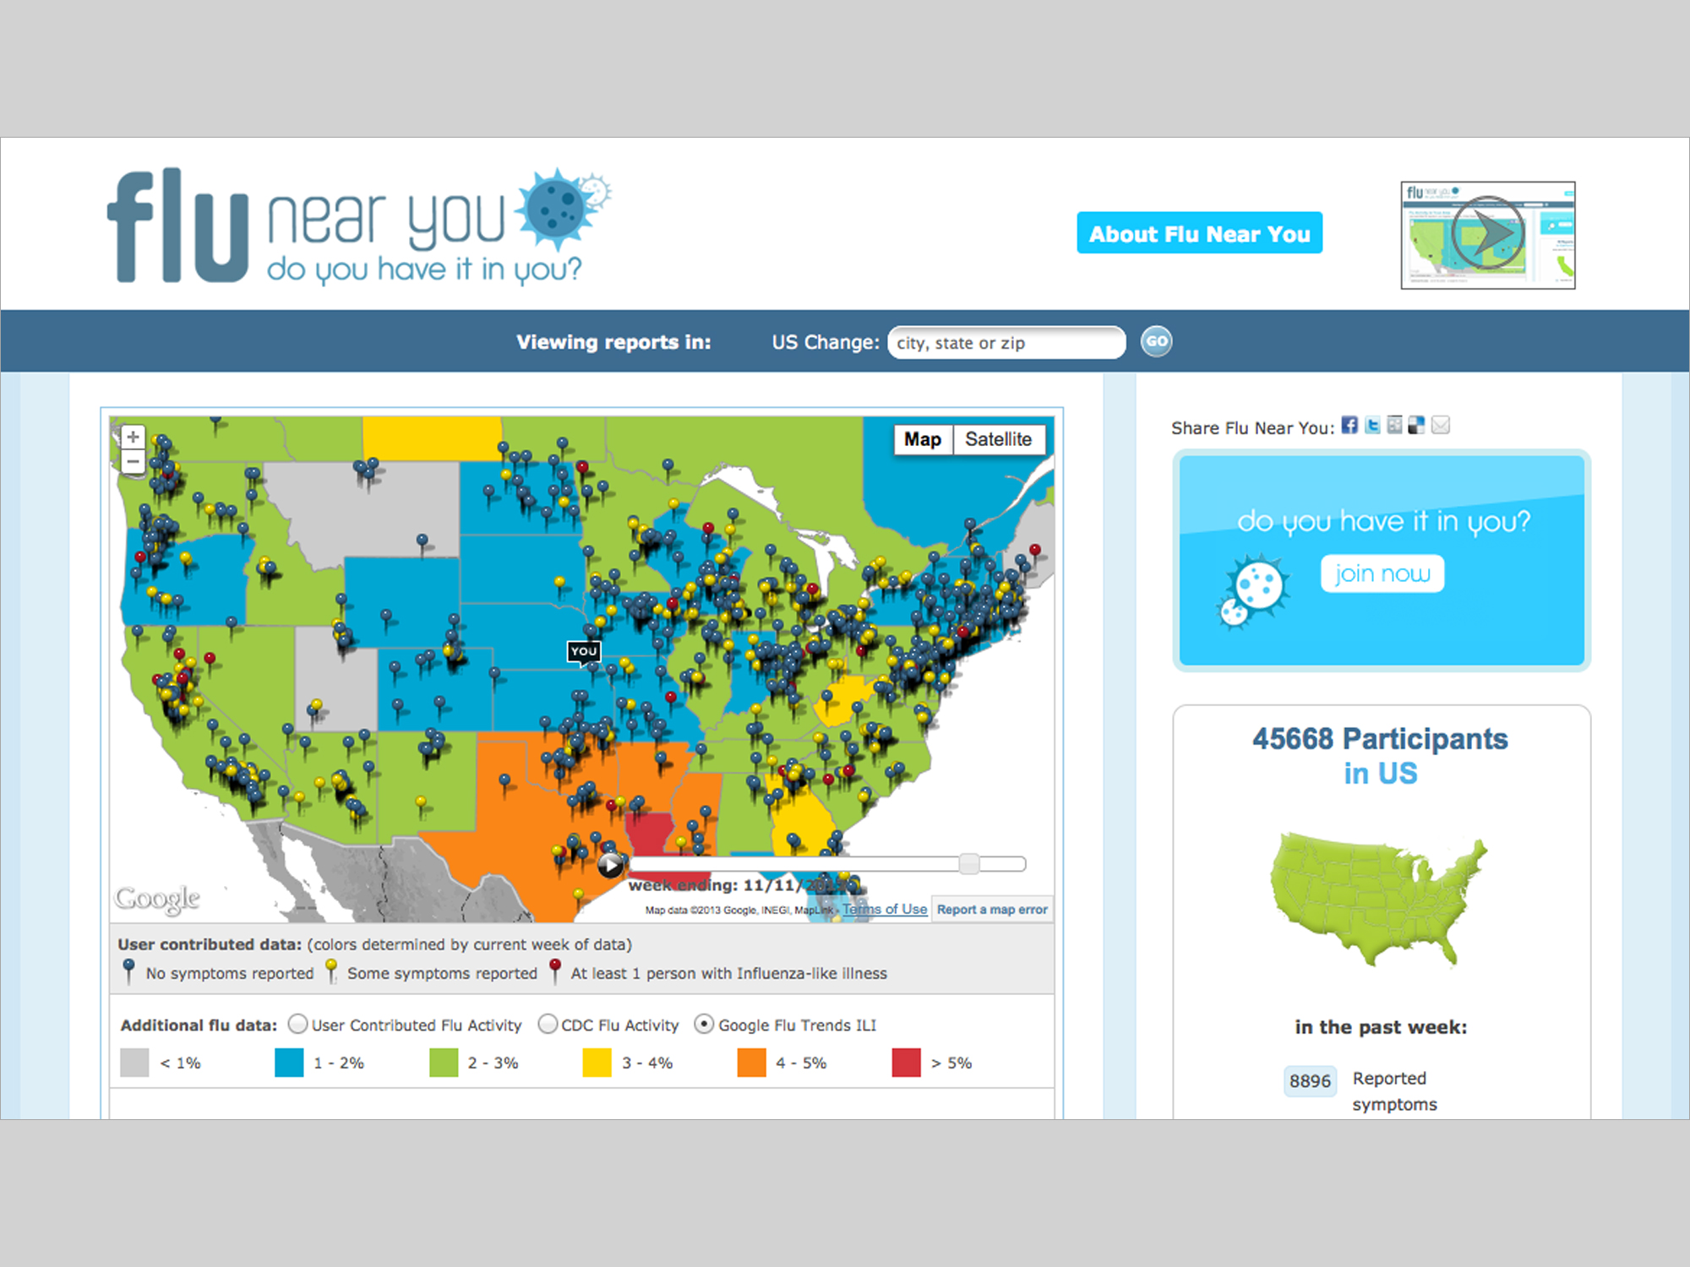

Slide 33
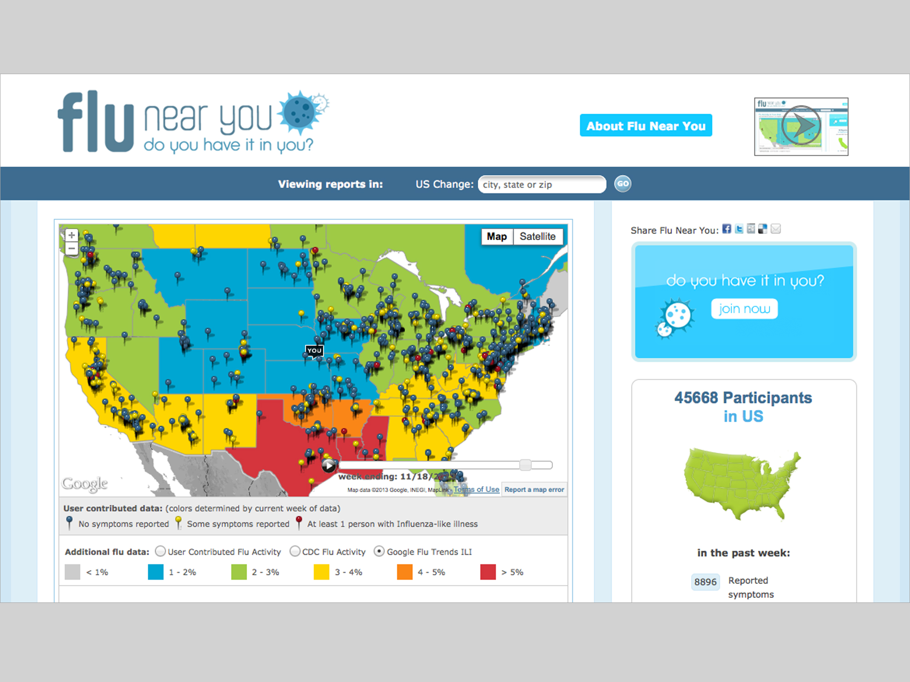

Slide 34
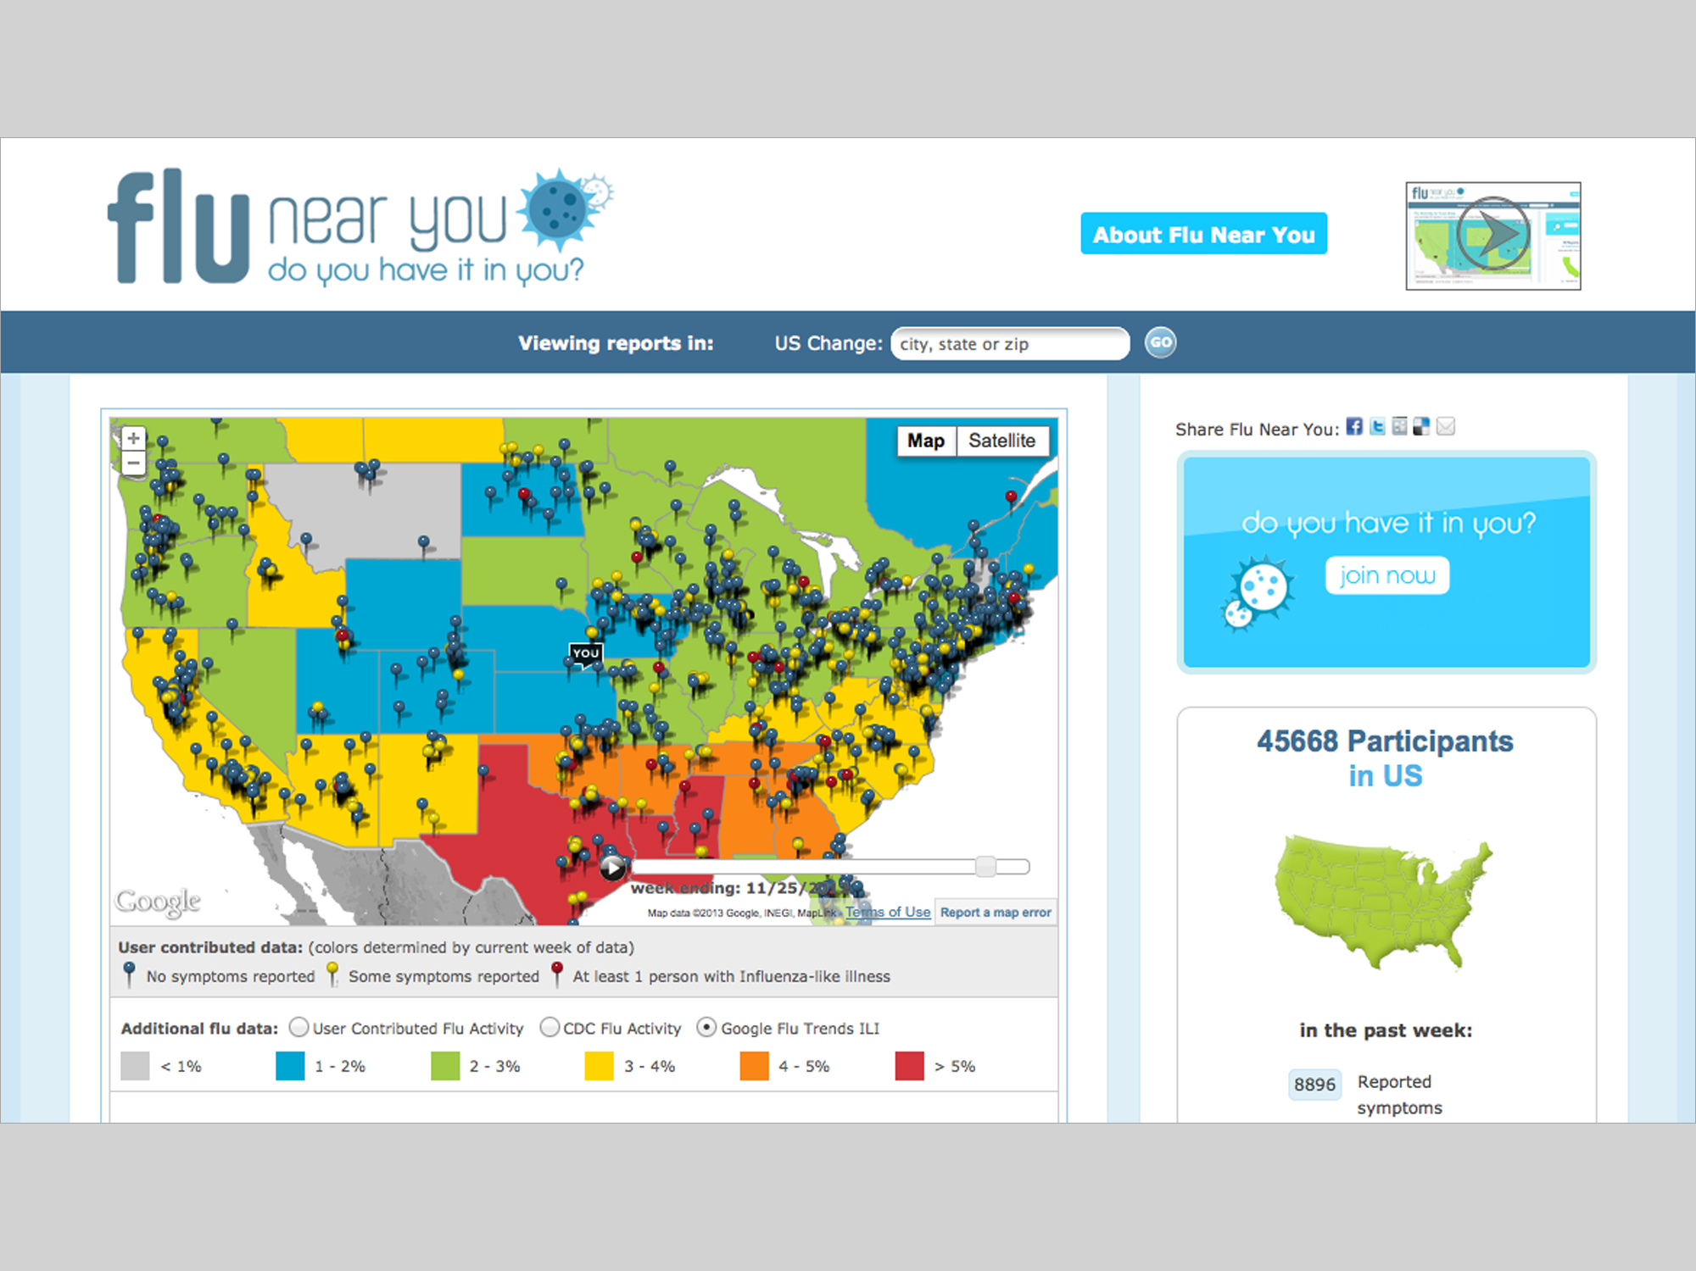

Slide 35
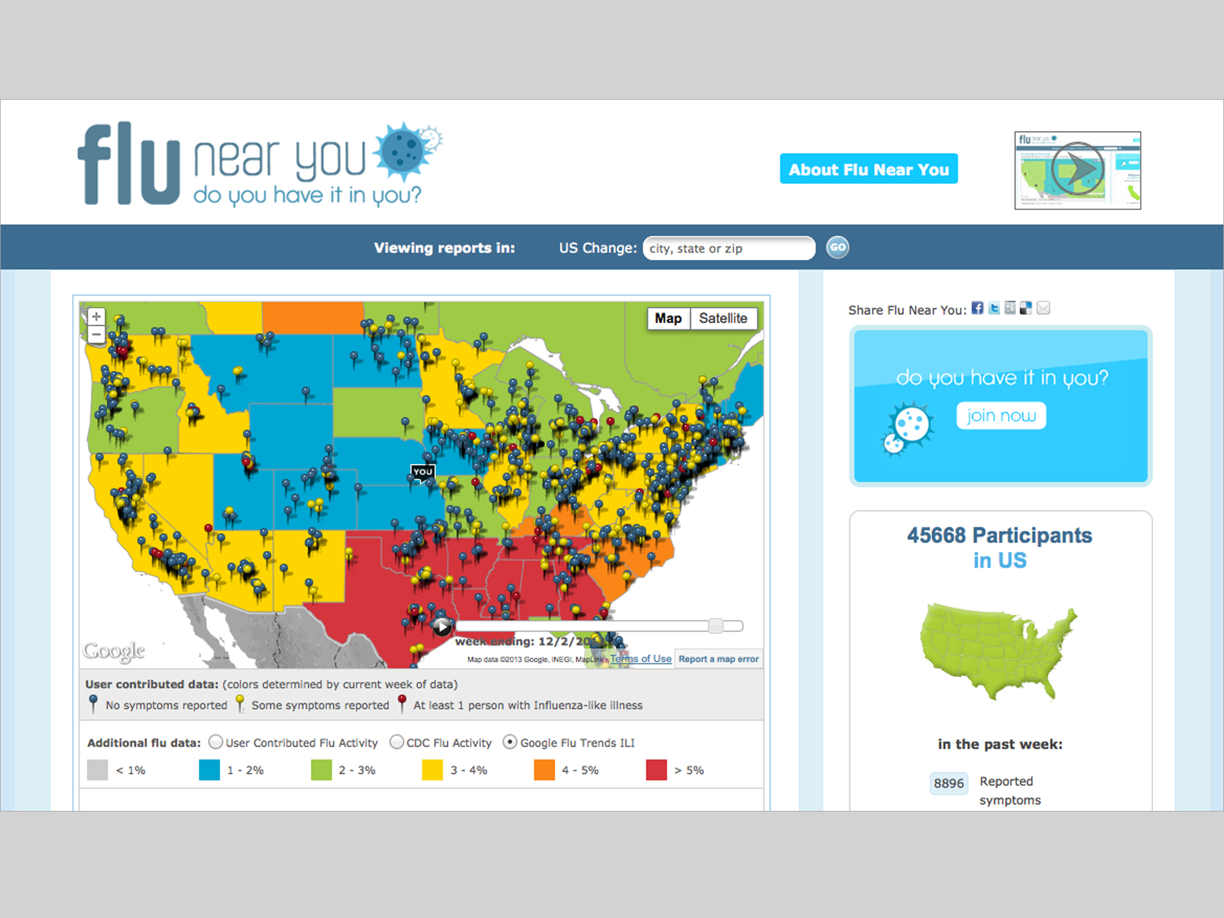

Slide 36
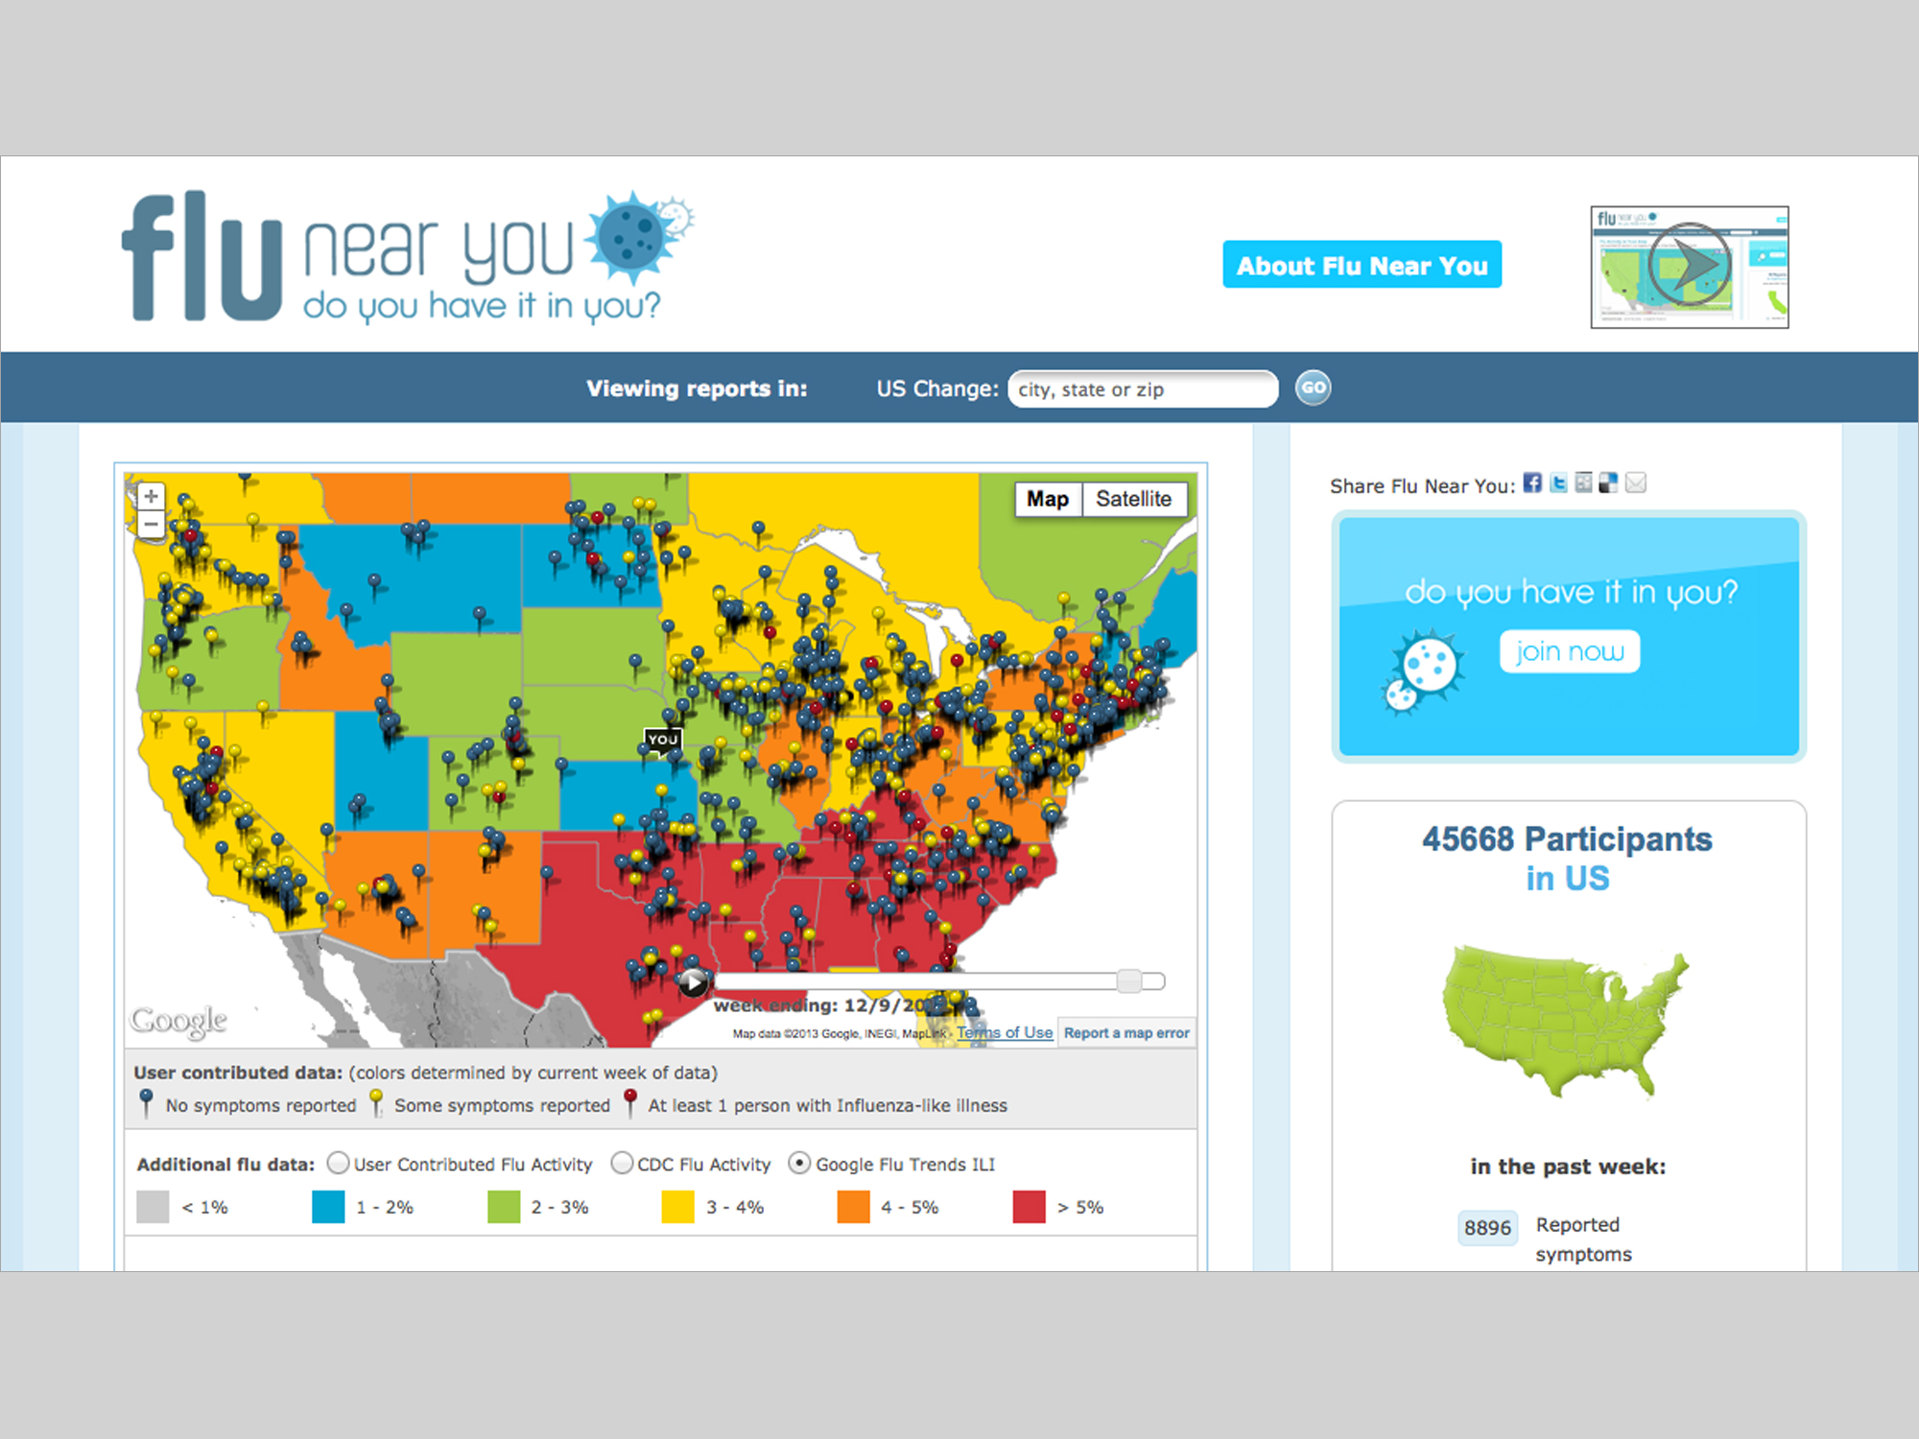

Slide 37
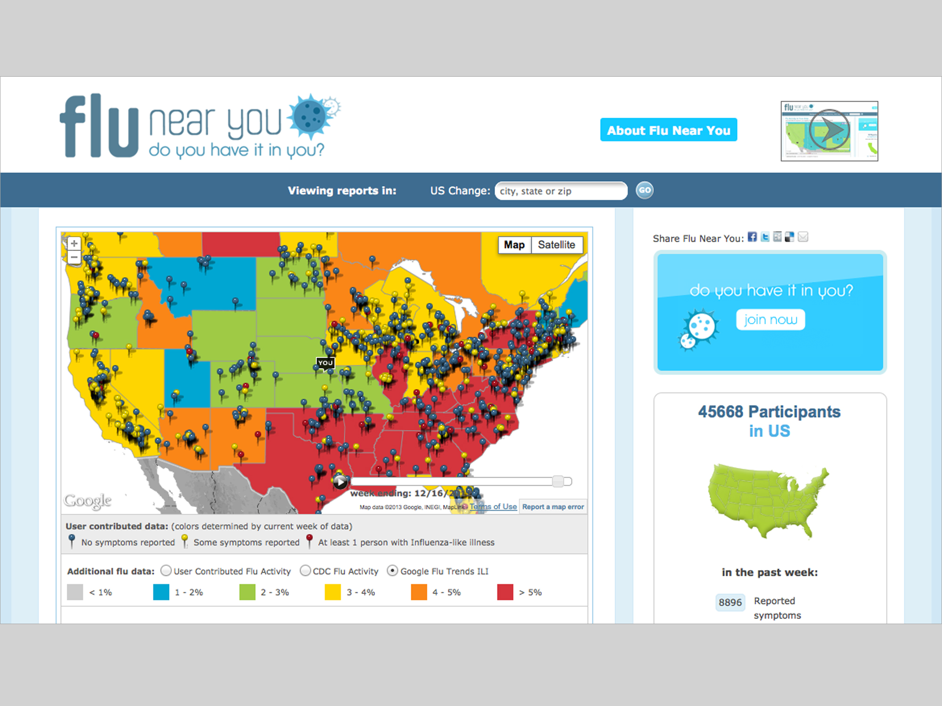

Slide 38
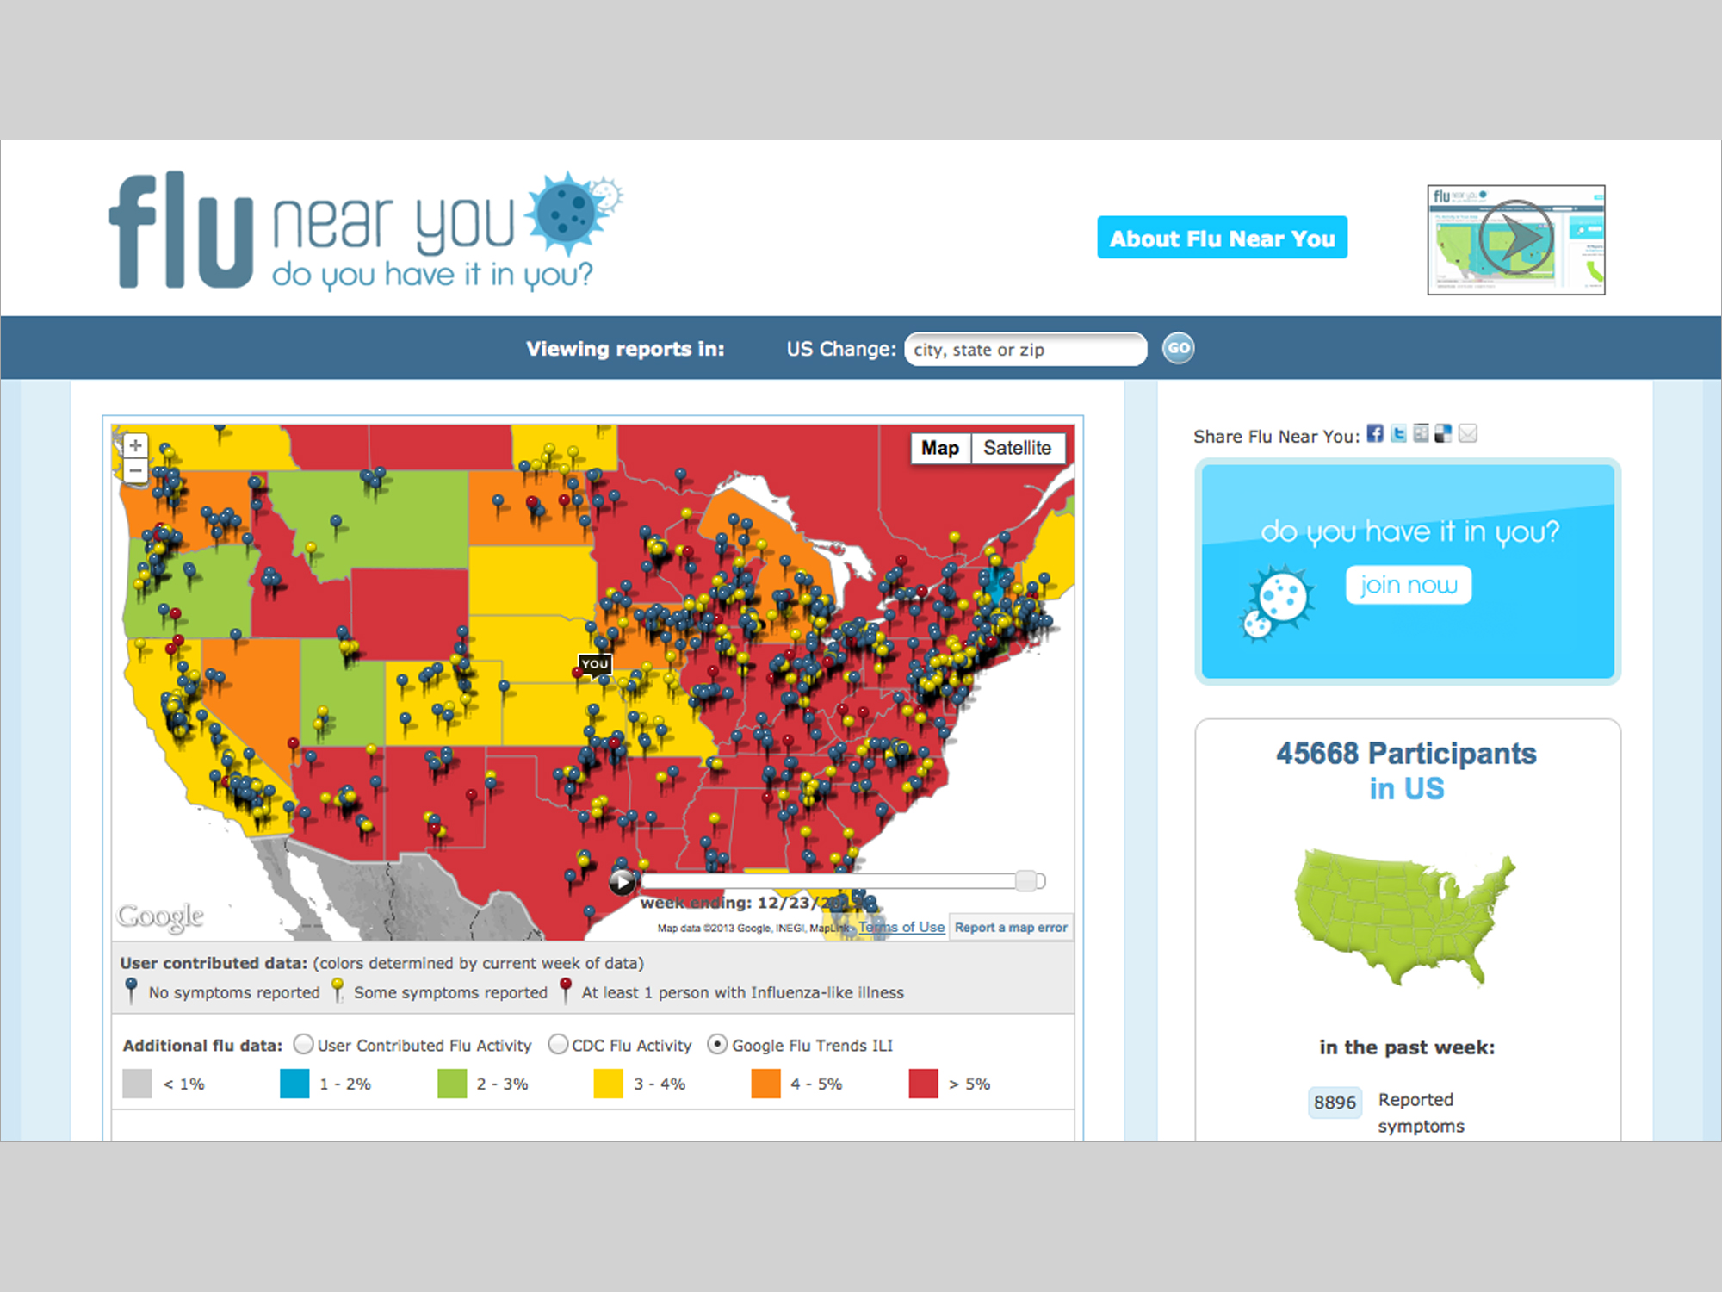

Slide 39
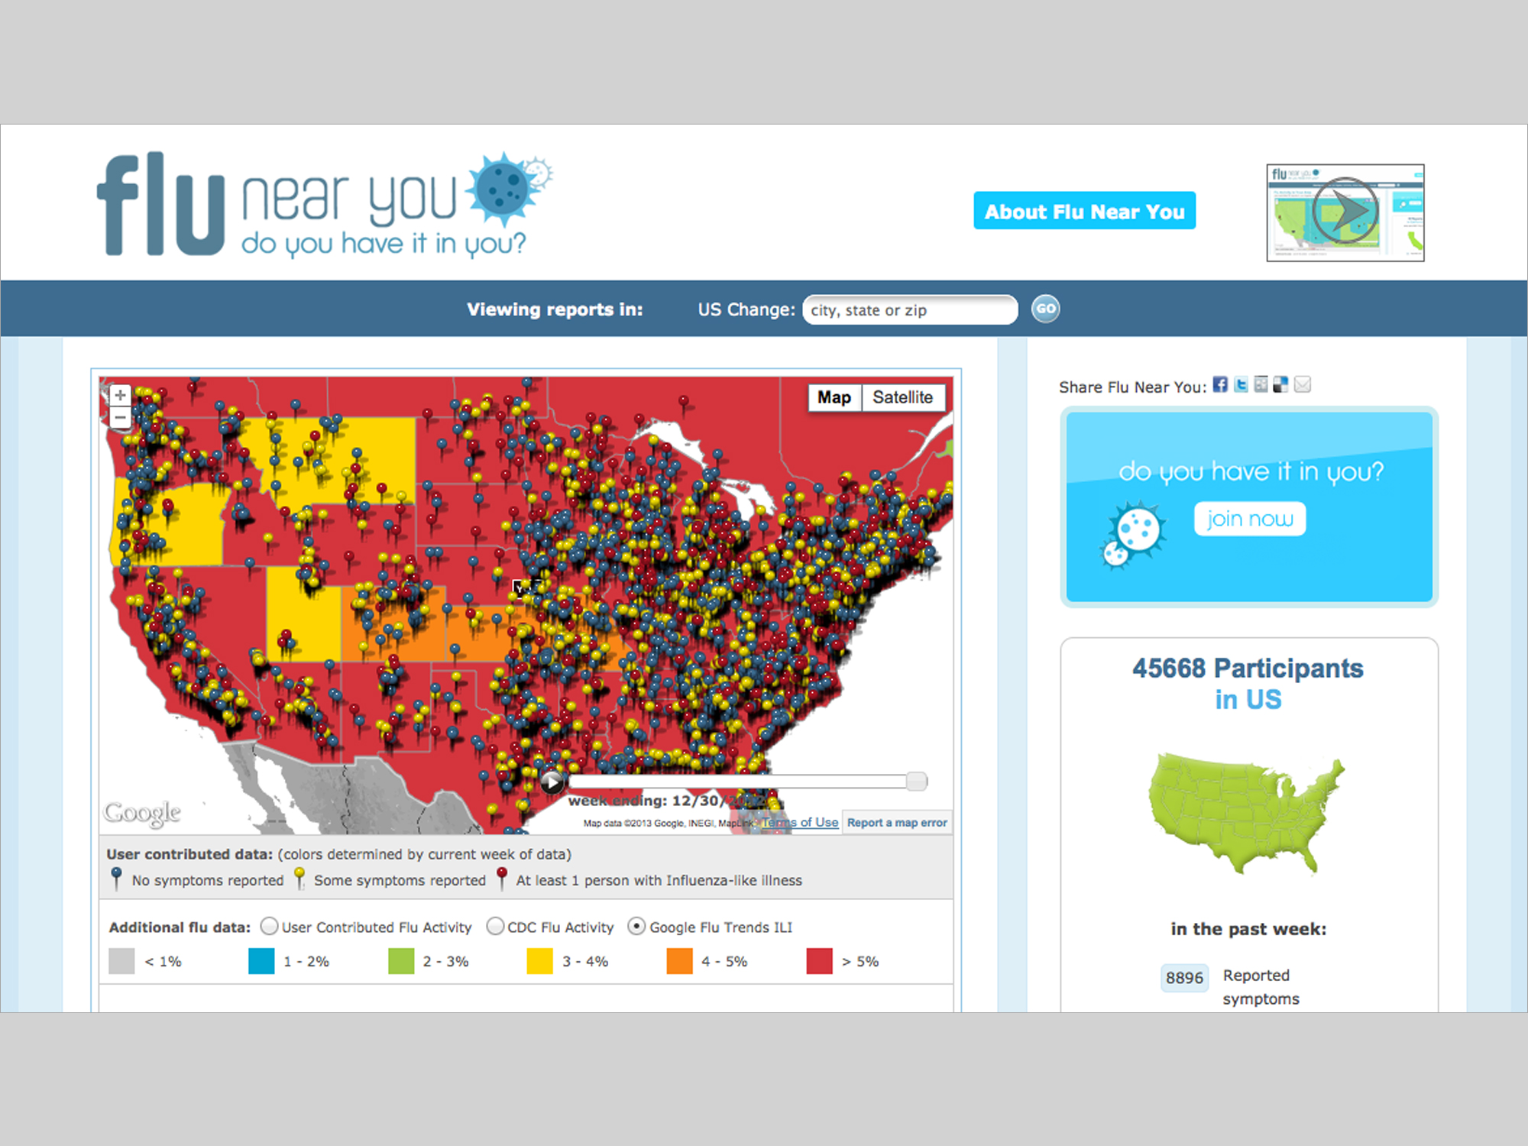

Slide 40
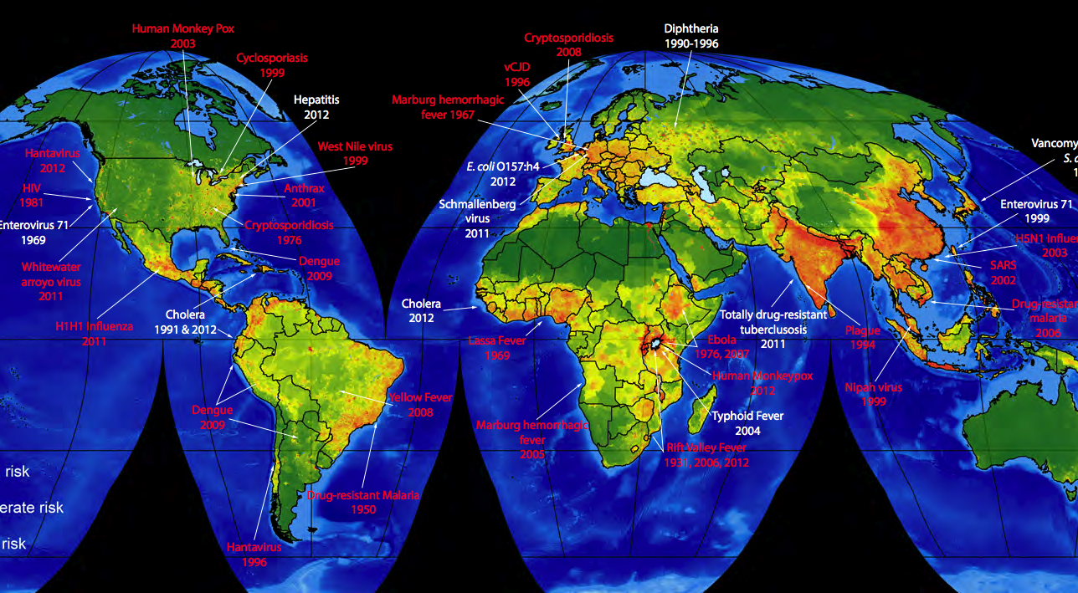
Hotspots for pandemic threats

Slide 41
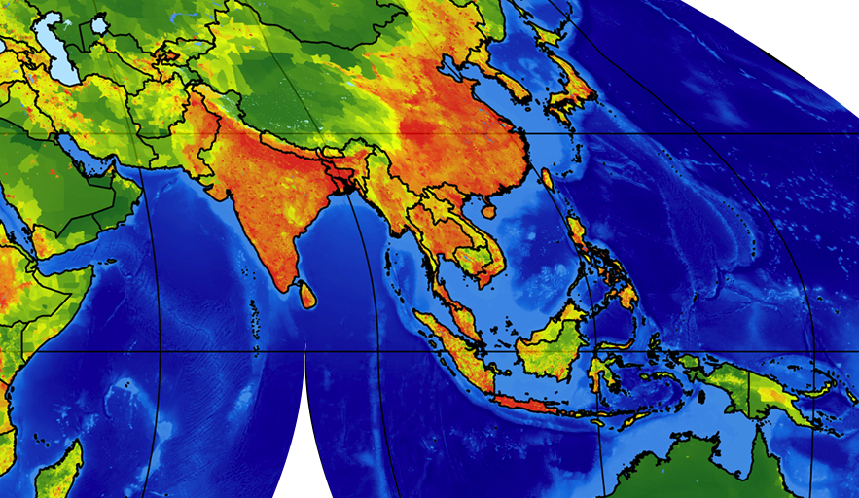

Slide 42
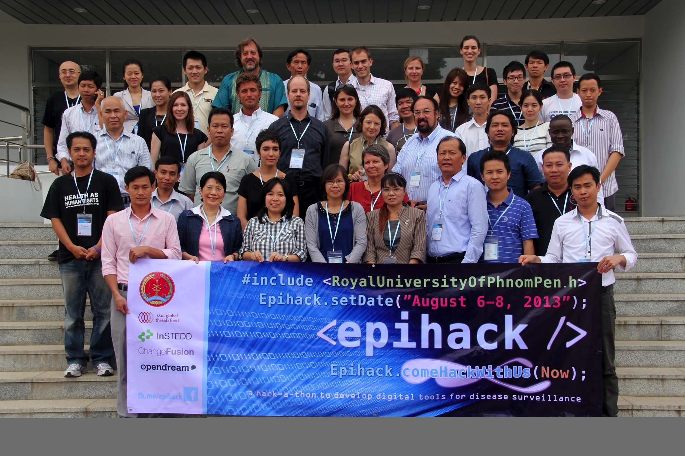

Slide 44

Thank you!
mark@skollglobalthreats.org
Notes:
----- Meeting Notes (1/29/13 18:14) -----
Skoll Global Threats Fund is a foundationcreated by Jeff Skoll, co-founder of eBay, Participant Media and the Skoll Foundation. He worried about a world of increasing complexity that could be brough to its knees by catastrophic risks, globla threats, in part brought on the same modernity that gives us hope for a better world. We owrk on pandemics, but also nuclear proliferation, climate change, water, and the Middle East.

